Slide 1
Point / Point-Region Quadtrees
CMSC 420

Slide 2
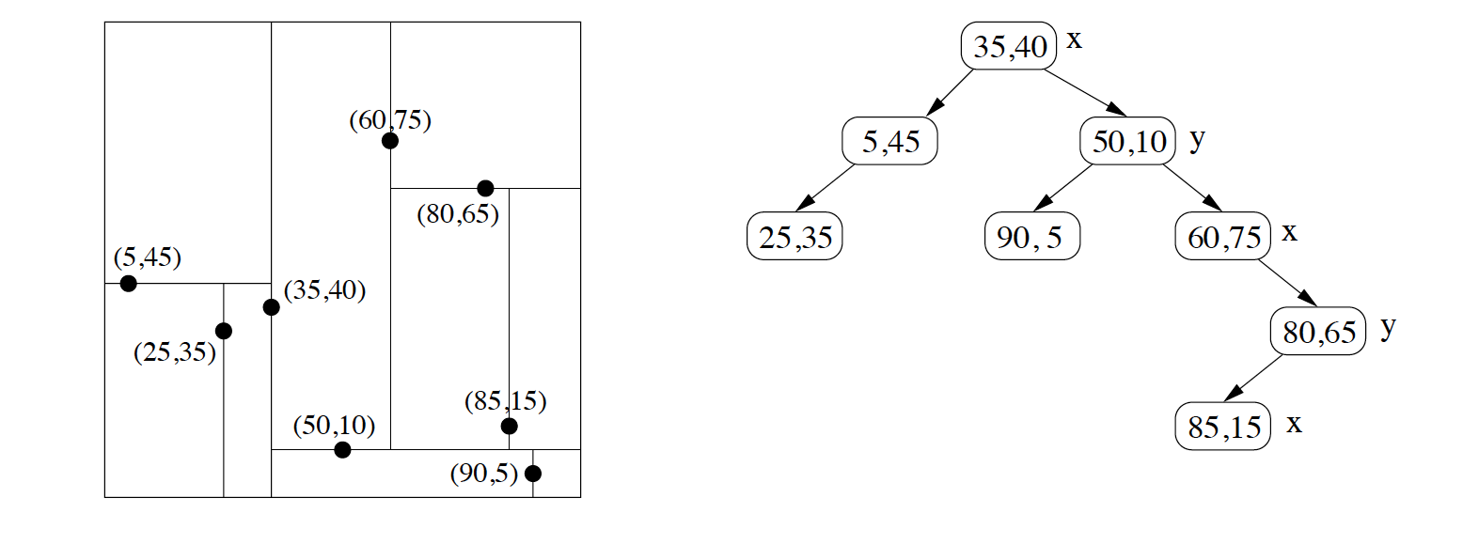
Reminder: KD-Tree Structure
KD-Trees are binary trees fully defined by the data points.

Slide 3
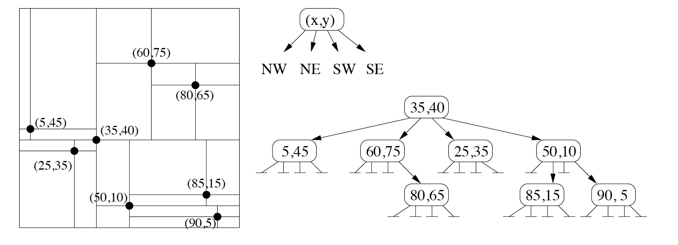
Reminder: KD-Tree Structure
Point-Quadtrees are a straightforward generalization from binary to 4-ary trees!

Slide 4
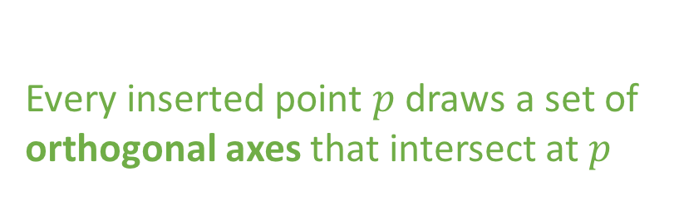
Reminder: KD-Tree Structure
Point-Quadtrees are a straightforward generalization from binary to 4-ary trees!
Every inserted point $p$draws a set of orthogonal axes that intersect at $p$

Slide 5
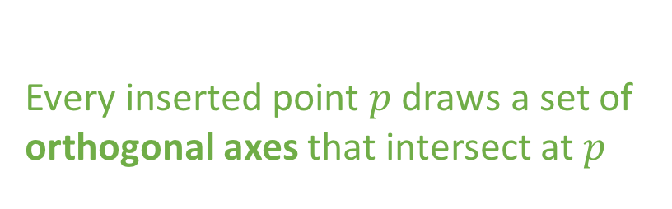
Reminder: KD-Tree Structure
Point-Quadtrees are a straightforward generalization from binary to 4-ary trees!
Every inserted point $p$draws a set of orthogonal axes that intersect at $p$
NW
NE
“Z” (Morton) order used for sorting children
SW
SE

Slide 6
Insertion into a Point Quadtree
Insertion is straightforward.
If current pointer is null, allocate space and return.
Otherwise, determine quadrant (with 2 comparisons) and recurse there.

Slide 7
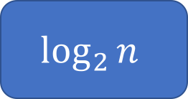
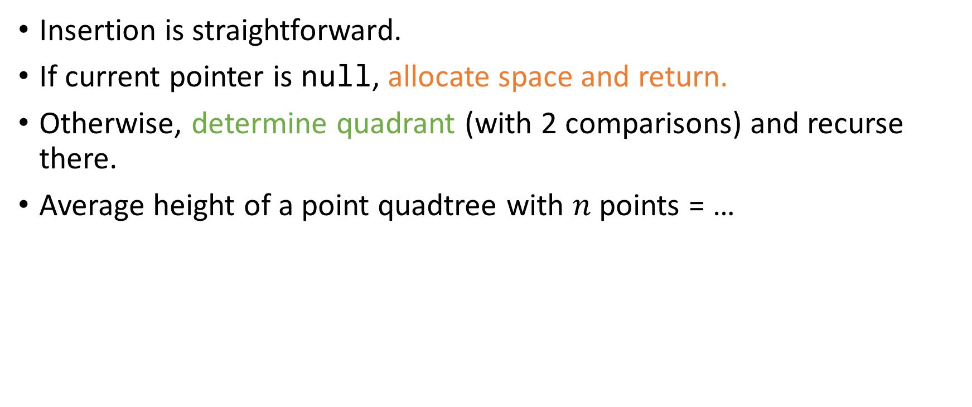
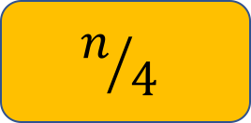
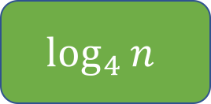
Insertion into a Point Quadtree
Insertion is straightforward.
If current pointer is null, allocate space and return.
Otherwise, determine quadrant (with 2 comparisons) and recurse there.
Average height of a point quadtree with $n$ points = …
$$\log_{2}{n}$$
$$\log_{4}{n}$$
$$n/4$$
Something Else

Slide 8
Insertion into a Point Quadtree
Insertion is straightforward.
If current pointer is null, allocate space and return.
Otherwise, determine quadrant (with 2 comparisons) and recurse there.
Average height of a point quadtree with $n$ points = …
$$\log_{2}{n}$$
$$\log_{4}{n}$$
$$n/4$$
Something Else
Remember: this means uniform distribution over inputs…

Slide 9
Deletion
Deletion from a Point QuadTree is… terrible. ☹
Find the point to be deleted, delete it
And re-insert all the points rooted in the relevant subtree ☹

Slide 10


Deletion
Deletion from a Point QuadTree is… terrible. ☹
Find the point to be deleted, delete it
And re-insert all the points rooted in the relevant subtree ☹
Hanan’s book has a better, but much more complicated algorithm for Point QuadTree deletion
If interested, ask Jason to post pseudocode on Piazza

Slide 11
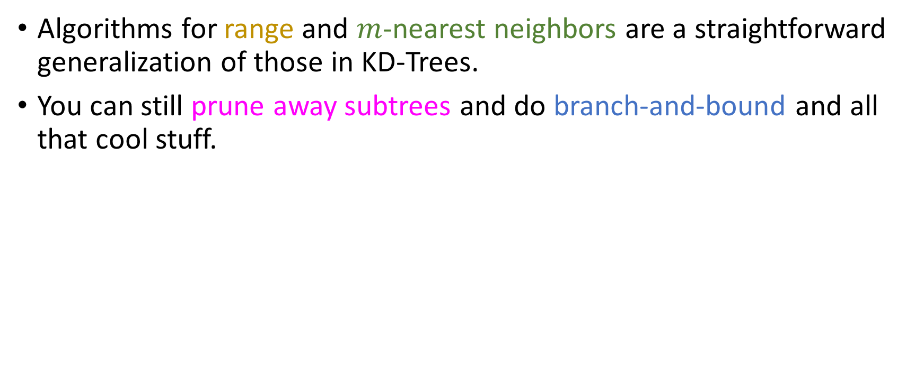

Range, $m$-NN, etc…
Algorithms for range and $m$-nearest neighbors are a straightforward generalization of those in KD-Trees.
You can still prune away subtrees and do branch-and-bound and all that cool stuff.

Slide 12
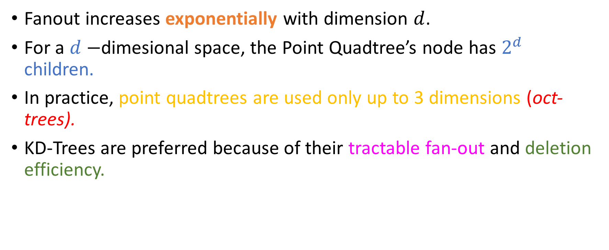
Main issue with point quadtrees
Fanout increases exponentially with dimension $d$.
For a $d−$dimesional space, the Point Quadtree’s node has $2^{d}$ children.
In practice, point quadtrees are used only up to 3 dimensions (oct-trees).
KD-Trees are preferred because of their tractable fan-out and deletion efficiency.

Slide 13
Data-based vs space-based representations
Point QuadTrees and KD-Trees have the common characteristic that they split based on data points.
This is not the only way: we can also build spatial data structures based on spatial decompositions!
Examples: Region Quadtrees, Point-Region (P-R) QuadTrees
We will talk about PR Quadtrees this semester and post some old slides on Region QuadTrees for your enlightenment

Slide 14
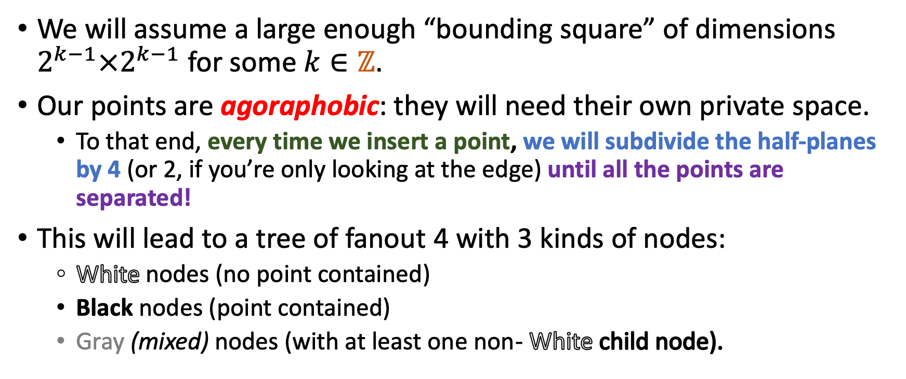
Main idea
We will assume a large enough “bounding square” of dimensions $2^{k−1}×2^{k−1}$ for some $k∈ℤ$.
Our points are agoraphobic: they will need their own private space.
To that end, every time we insert a point, we will subdivide the half-planes by 4 (or 2, if you’re only looking at the edge) until all the points are separated!
This will lead to a tree of fanout 4 with 3 kinds of nodes:
White nodes (no point contained)
Black nodes (point contained)
Gray (mixed) nodes (with at least one non- White child node).
Notes:
White

Slide 15

Example
Space
PR-QuadTree
(0, 32)
(-32, 0)
(32, 0)
(0, -32)
Suppose we select $k=6⇒2^{k}=64$…
No stored points yet: All we have is a white node!

Slide 16
Example
Space
PR-QuadTree
(0, 32)
(-10, 2)
(-10, 2)
(-32, 0)
(32, 0)
(0, -32)
Stored a single point: Entire quadtree is now a black node!

Slide 17
Example
Space
PR-QuadTree
(0, 32)
(-10, 2)
I appreciate my solitude
(-10, 2)
(-32, 0)
(32, 0)
(0, -32)
Stored a single point: Entire quadtree is now a black node!

Slide 18
Example
Space
PR-QuadTree
(0, 32)
(-10, 2)
NOPE NOPE NOPE NOPE NOPE
(-10, 2)
Ohai
(-32, 0)
(32, 0)
(-20, -20)
(0, -32)
Inserting (-20, -20) causes too much commotion in the black node!
Split into gray node and 4 children.

Slide 19

Example
Space
PR-QuadTree
(0, 32)
This works
?
?
?
?
(-10, 2)
(-32, 0)
(32, 0)
(-20, -20)
Colors and contents of these nodes?
Indeed
(0, -32)
Inserting (-20, -20) causes too much commotion in the black node!
Split into gray node and 4 children.

Slide 20

Example
Space
PR-QuadTree
(0, 32)
This works
(-10, 2)
(-20, -20)
?
(-10, 2)
(-32, 0)
(32, 0)
(-20, -20)
Colors and contents of these nodes?
Indeed
(0, -32)
Inserting (-20, -20) causes too much commotion in the black node!
Split into gray node and 4 children.
We still do Morton (“Z”) order for traversing the children!

Slide 21
Example
Space
PR-QuadTree
(0, 32)
(2, 20)
(-10, 2)
(2, 20)
(-20, -20)
?
(-10, 2)
(-32, 0)
(32, 0)
(-20, -20)
(0, -32)

Slide 22
Example
Space
PR-QuadTree
(0, 32)
(2, 20)
(-10, 2)
(2, 20)
(-20, -20)
(28, -4)
(-10, 2)
(-32, 0)
(32, 0)
(28, -4)
(-20, -20)
(0, -32)

Slide 23
Example
Space
PR-QuadTree
(0, 32)
(2, 20)
(-10, 2)
(-20, -20)
(28, -4)
(-10, 2)
(4, 2)
(-32, 0)
(32, 0)
(28, -4)
(-20, -20)
(0, -32)

Slide 24
Example
Space
PR-QuadTree
(0, 32)
(2, 20)
Well, this looks crowded
(-10, 2)
(-20, -20)
(28, -4)
(-10, 2)
(4, 2)
(-32, 0)
(32, 0)
(28, -4)
(-20, -20)
My exact thoughts
(0, -32)

Slide 25
Example
Space
PR-QuadTree
(0, 32)
(2, 20)
Much better
(-10, 2)
(-20, -20)
(28, -4)
(-10, 2)
(4, 2)
(-32, 0)
(32, 0)
(2, 20)
(2, 20)
(28, -4)
(2, 20)
(4, 2)
(-20, -20)
No kidding
(0, -32)

Slide 26
Example
Space
PR-QuadTree
(0, 32)
(2, 20)
(-10, 2)
(-20, -20)
(28, -4)
(-10, 2)
(4, 2)
(-32, 0)
(32, 0)
(2, 20)
(2, 20)
(28, -4)
(2, 20)
(4, 2)
(-20, -20)
(23, -10)
(0, -32)

Slide 27
Example
Space
PR-QuadTree
(0, 32)
(2, 20)
(-10, 2)
(-20, -20)
(28, -4)
(-10, 2)
(4, 2)
(-32, 0)
(32, 0)
(2, 20)
(2, 20)
(28, -4)
(2, 20)
Are you at least going to be paying rent?
(4, 2)
(-20, -20)
(23, -10)
In your dreams, pal
(0, -32)

Slide 28
Example
Space
PR-QuadTree
(0, 32)
(2, 20)
(-10, 2)
(-10, 2)
(-20, -20)
(4, 2)
(-32, 0)
(32, 0)
(2, 20)
(2, 20)
16
(28, -4)
(2, 20)
Well, this did nothing
(4, 2)
(28, -4)
(-20, -20)
(23, -10)
-16
You don’t say
(0, -32)

Slide 29
Example
Space
PR-QuadTree
(0, 32)
(2, 20)
(-10, 2)
(-10, 2)
(-20, -20)
(4, 2)
(-32, 0)
24
(32, 0)
(2, 20)
(2, 20)
16
(28, -4)
(2, 20)
(4, 2)
Sweeeeeet
(-20, -20)
-8
(23, -10)
-16
No doubt
(28, -4)
(23, -10)
(0, -32)

Slide 30
Splitting at 2 all the time ?
This aggressive splitting seems wasteful.
When inserting 2 points very close to each other, we might even have to investigate negative powers of 2!

Slide 31
Splitting at 2 all the time ?
This aggressive splitting seems wasteful.
When inserting 2 points very close to each other, we might even have to investigate negative powers of 2!
Two ways to deal with this:

Slide 32
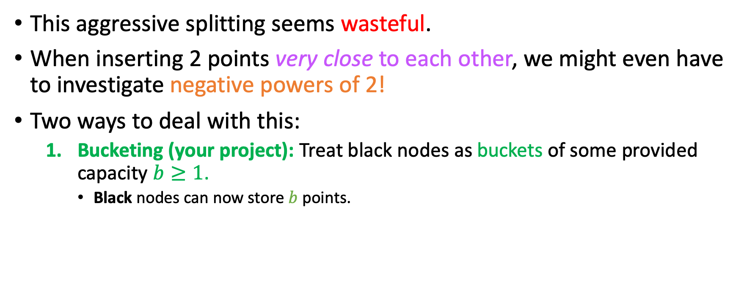
Splitting at 2 all the time ?
This aggressive splitting seems wasteful.
When inserting 2 points very close to each other, we might even have to investigate negative powers of 2!
Two ways to deal with this:
Bucketing (your project): Treat black nodes as buckets of some provided capacity $b≥1$.
Black nodes can now store $b$ points.

Slide 33
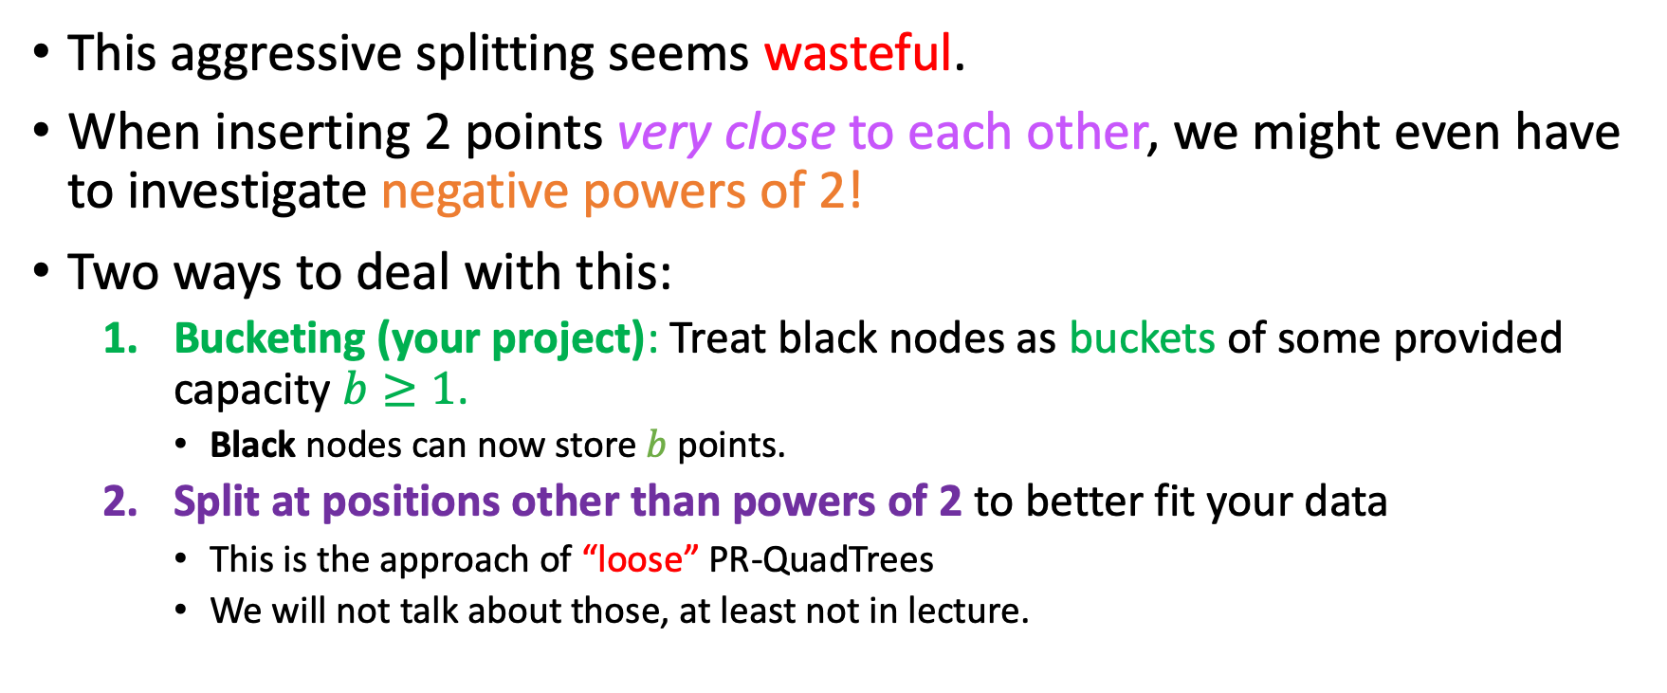
Splitting at 2 all the time ?
This aggressive splitting seems wasteful.
When inserting 2 points very close to each other, we might even have to investigate negative powers of 2!
Two ways to deal with this:
Bucketing (your project): Treat black nodes as buckets of some provided capacity $b≥1$.
Black nodes can now store $b$ points.
Split at positions other than powers of 2 to better fit your data
This is the approach of “loose” PR-QuadTrees
We will not talk about those, at least not in lecture.

Slide 34
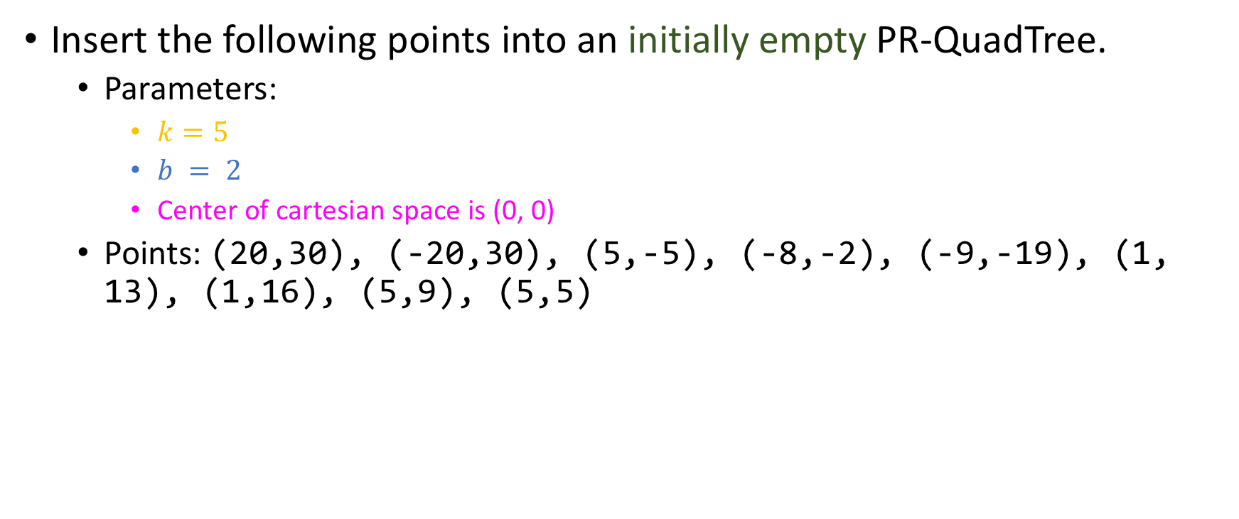
Exercise!
Insert the following points into an initially empty PR-QuadTree.
Parameters:
$k=5$
$b = 2$
Center of cartesian space is (0, 0)
Points: (20,30), (-20,30), (5,-5), (-8,-2), (-9,-19), (1, 13), (1,16), (5,9), (5,5)

Slide 35
Conjectures
Gray nodes with 3 white children and 1 black child are useless and can be pruned.
True
False

Slide 36

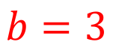
Conjectures
Gray nodes with 3 white children and 1 black child are useless and can be pruned.
True
False
16
(3, -12), (11, -5), (3, -3)
-16
16
(3, -3)
(11, -5)
(3, -12)
-16
$$b=3$$

Slide 37
Conjectures
Gray nodes with 3 white children and 1 black child are useless and can be pruned.
True
False
16
(3, -12), (11, -5), (3, -3)
Still happy?
Yup
-16
16
Same
(3, -3)
(11, -5)
No need for further separation if there are no neighbors to “annoy” the current points!
(3, -12), (11, -5), (3, -3)
(3, -12)
-16
$$b=3$$

Slide 38
Conjectures
Gray nodes with only black and white children are useless and can be pruned.
True
False

Slide 39


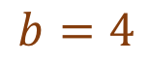
Conjectures
Gray nodes with only black and white children are useless and can be pruned.
True
False
Get out of my personal space, personal space
16
Personal space
(6, 10)
(-8, 4)
(8, 4)
(-8, 4)
-16
16
(6, 10),
(8, 4)
(-4 -8),
(-12, -14)
Personal space
(-4, -8)
(-12, -14)
Personal space
What if merging them all into a new black node surpasses parameter $b$?
Personal space
-16
$$b=4$$

Slide 40
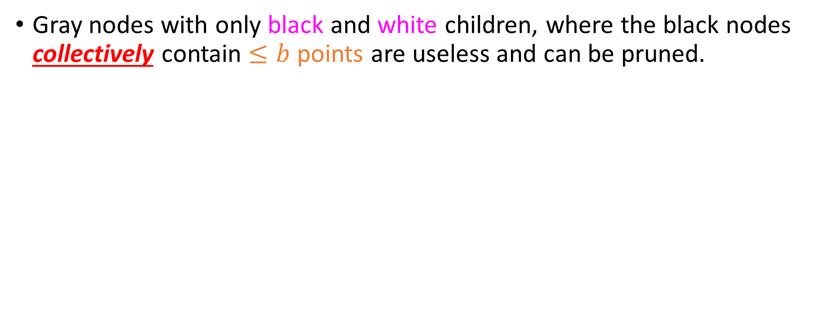
Conjectures
Gray nodes with only black and white children, where the black nodes collectively contain $≤b$ points are useless and can be pruned.
True
False

Slide 41


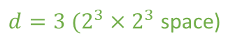
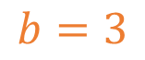
Conjectures
Gray nodes with only black and white children, where the black nodes collectively contain $≤b$ points are useless and can be pruned.
True
False
$d=3 (2^{3}×2^{3}$ space)
(-3, 4), (4, 6), (3, 3)
(4, 6)
(-3, 4)
(-3, 4)
(4, 6)
(3, 3)
(4, 6), (3, 3)
(-3, 4)
(3, 3)
$$b=3$$

Slide 42
Conjectures
In a PR-QuadTree, black and white nodes can only be leaf nodes.
True
False

Slide 43
Conjectures
In a PR-QuadTree, black and white nodes can only be leaf nodes.
True
False
16
(15, 15)
-16
(13, -2)
16
(15, -1)
Think about it this way: If a node is not a leaf node, then this means that it has children.
In order for it to have children, it must be a grey node
(12, -7)
(13, -2),
(15, -1)
(12, -7)
-16

Slide 44
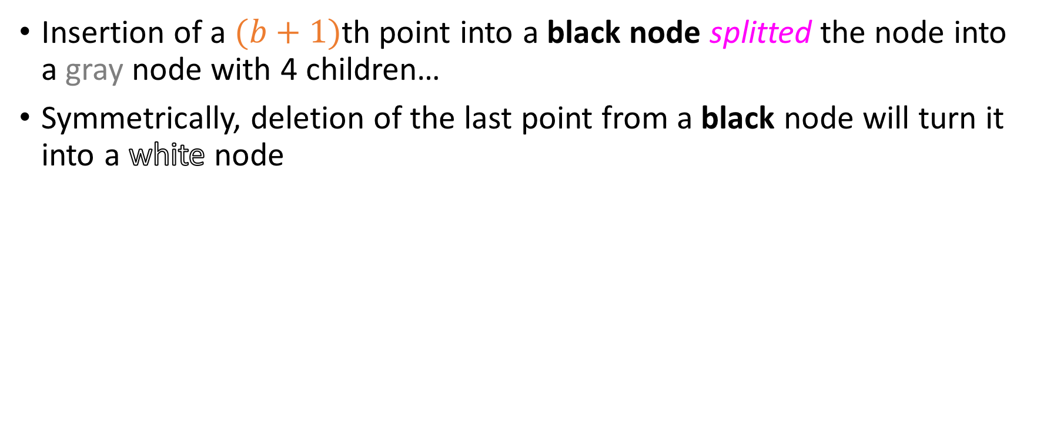
Deletion…
Insertion of a $(b+1)$th point into a black node splitted the node into a gray node with 4 children…
Symmetrically, deletion of the last point from a black node will turn it into a white node

Slide 45
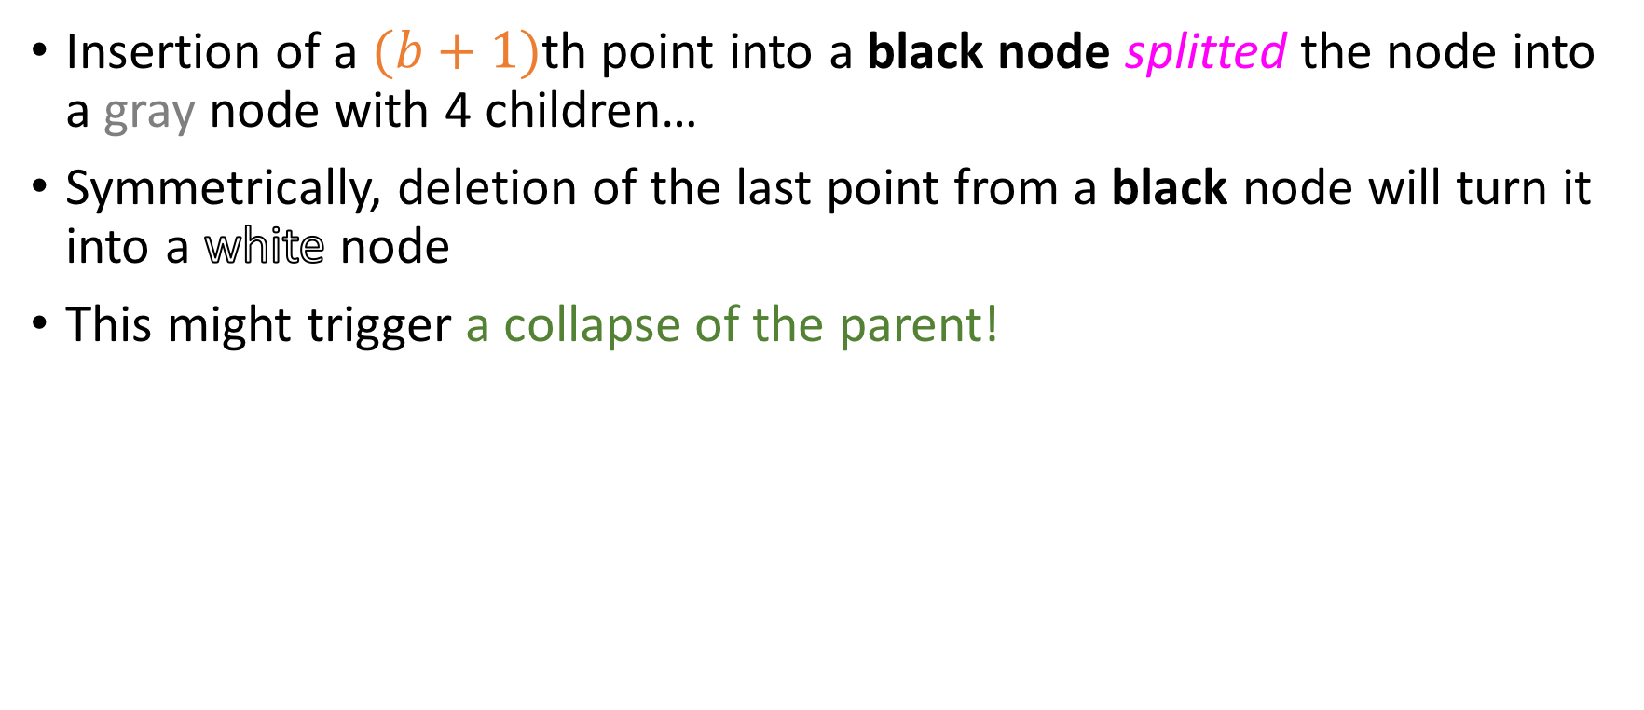
Deletion…
Insertion of a $(b+1)$th point into a black node splitted the node into a gray node with 4 children…
Symmetrically, deletion of the last point from a black node will turn it into a white node
This might trigger a collapse of the parent!

Slide 46
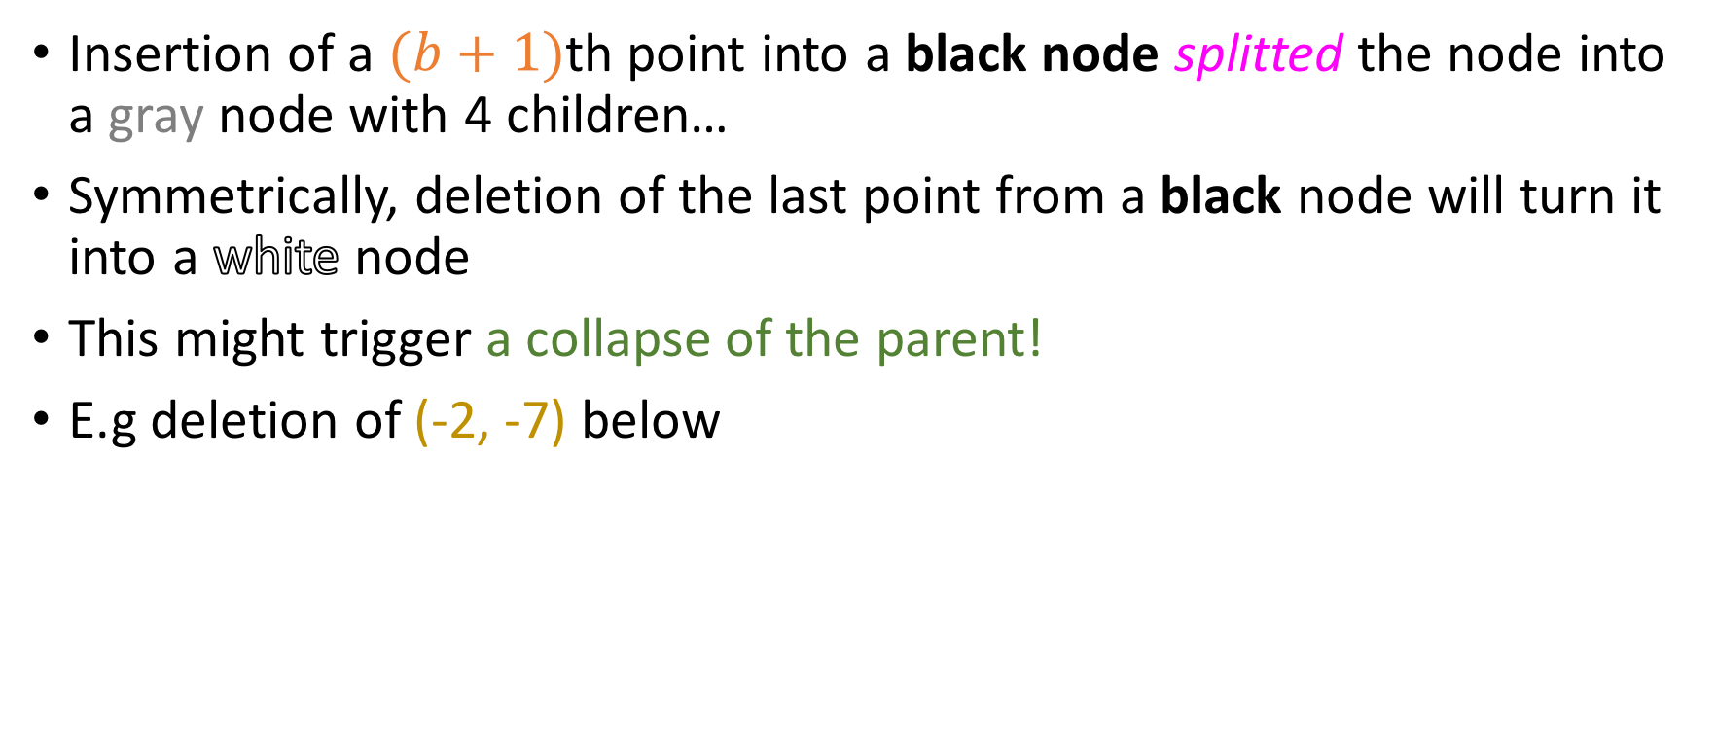
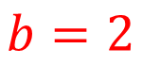
Deletion…
Insertion of a $(b+1)$th point into a black node splitted the node into a gray node with 4 children…
Symmetrically, deletion of the last point from a black node will turn it into a white node
This might trigger a collapse of the parent!
E.g deletion of (-2, -7) below
8
(3,-3), (7, -3)
(-2, -7)
-8
8
(-2, -7)
(3, -3)
(7, -3)
$$b=2$$
-8

Slide 47
Deletion…
Insertion of a $(b+1)$th point into a black node splitted the node into a gray node with 4 children…
Symmetrically, deletion of the last point from a black node will turn it into a white node
This might trigger a collapse of the parent!
E.g deletion of (-2, -7) below
8
(3,-3), (7, -3)
-8
8
(3, -3)
(7, -3)
$$b=2$$
-8

Slide 48
Deletion…
Insertion of a $(b+1)$th point into a black node splitted the node into a gray node with 4 children…
Symmetrically, deletion of the last point from a black node will turn it into a white node
This might trigger a collapse of the parent!
E.g deletion of (-2, -7) below
8
(3,-3), (7, -3)
-8
8
(3, -3)
(7, -3)
$$b=2$$
-8

Slide 49
“Trie – Based” quadtrees?
Many resources, including the bible, call quadtrees like the PR “trie-based” quadtrees.

Slide 50

“Trie – Based” quadtrees?
Many resources, including the bible, call quadtrees like the PR “trie-based” quadtrees.
For a long time, Jason could not understand why.

Slide 51
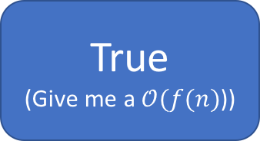
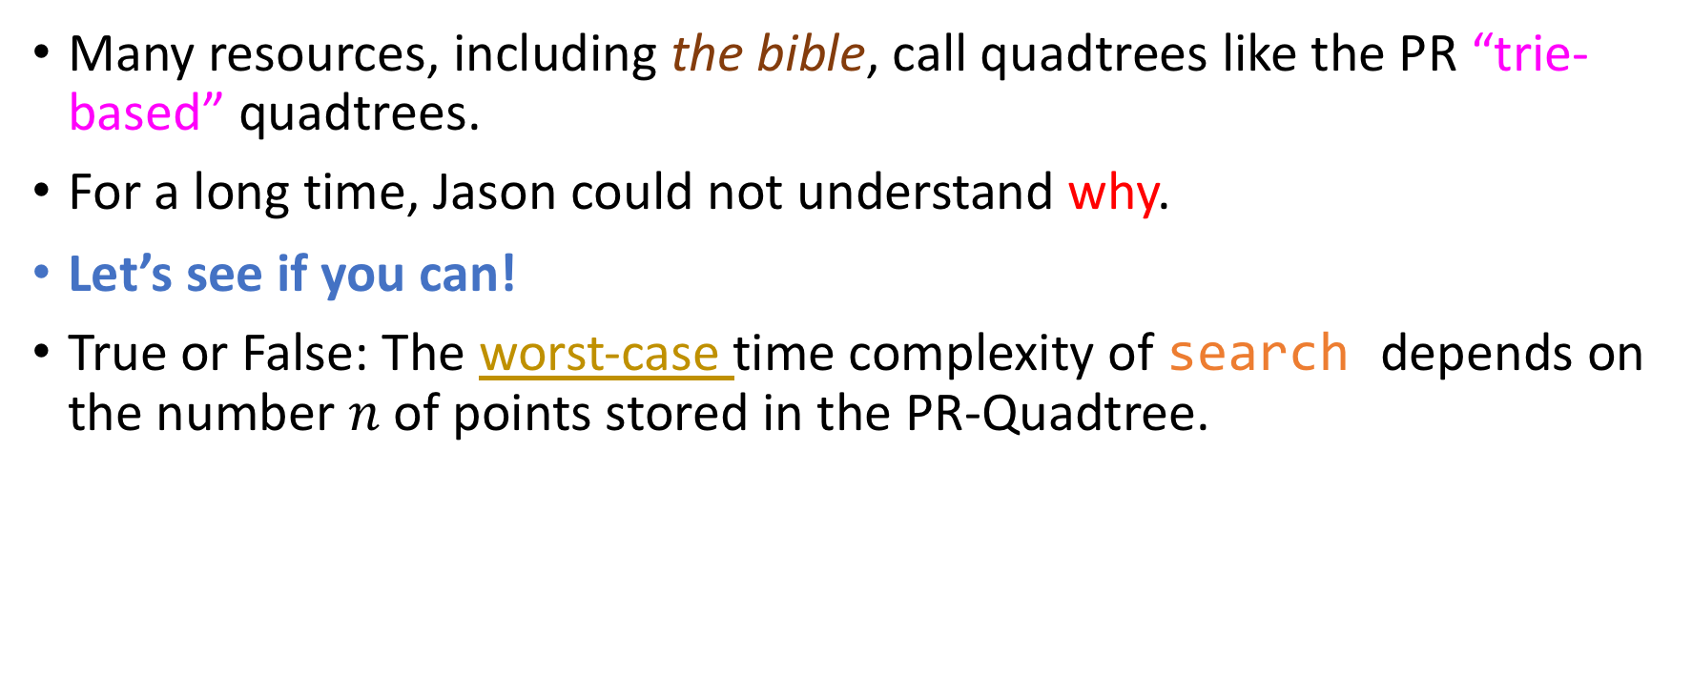
“Trie – Based” quadtrees?
Many resources, including the bible, call quadtrees like the PR “trie-based” quadtrees.
For a long time, Jason could not understand why.
Let’s see if you can!
True or False: The worst-case time complexity of search depends on the number $n$ of points stored in the PR-Quadtree.
True (Give me a $𝒪(f(n)$))
False (What does it depend on, then?)

Slide 52

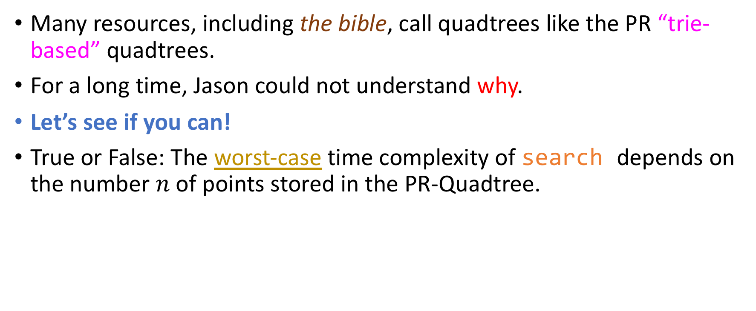
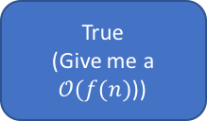
“Trie – Based” quadtrees?
Many resources, including the bible, call quadtrees like the PR “trie-based” quadtrees.
For a long time, Jason could not understand why.
Let’s see if you can!
True or False: The worst-case time complexity of search depends on the number $n$ of points stored in the PR-Quadtree.
True (Give me a $𝒪(f(n)$))
False (What does it depend on, then?)
Worst case produced by the minimum distance between two points!

Slide 53
Spatial Queries in PR-Quadtrees
Descending phase: Still aggressively descending towards anchor point, to cover as many points as we can in a short amount of time.

Slide 54
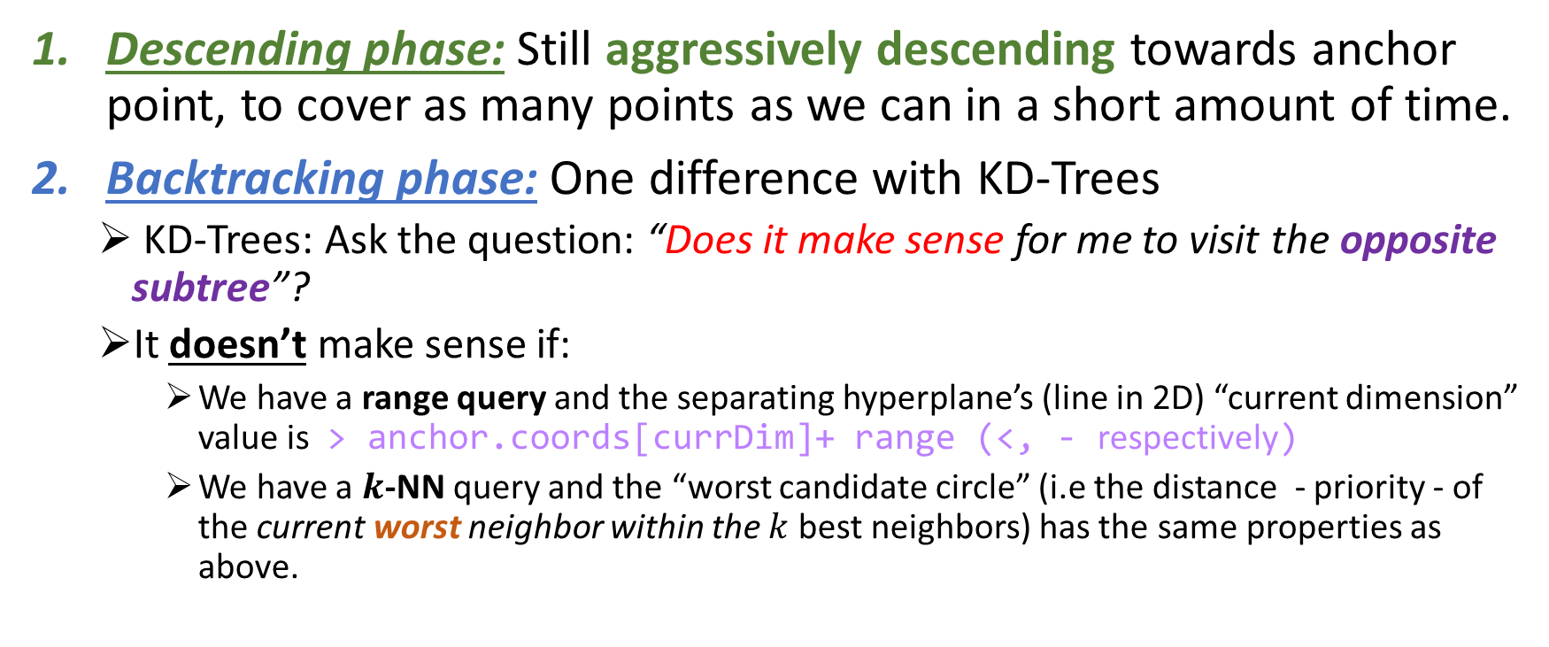
Spatial Queries in PR-Quadtrees
Descending phase: Still aggressively descending towards anchor point, to cover as many points as we can in a short amount of time.
Backtracking phase: One difference with KD-Trees
KD-Trees: Ask the question: “Does it make sense for me to visit the opposite subtree”?
It doesn’t make sense if:
We have a range query and the separating hyperplane’s (line in 2D) “current dimension” value is > anchor.coords[currDim]+ range (<, - respectively)
We have a $k$-NN query and the “worst candidate circle” (i.e the distance - priority - of the current worst neighbor within the $k$ best neighbors) has the same properties as above.

Slide 55
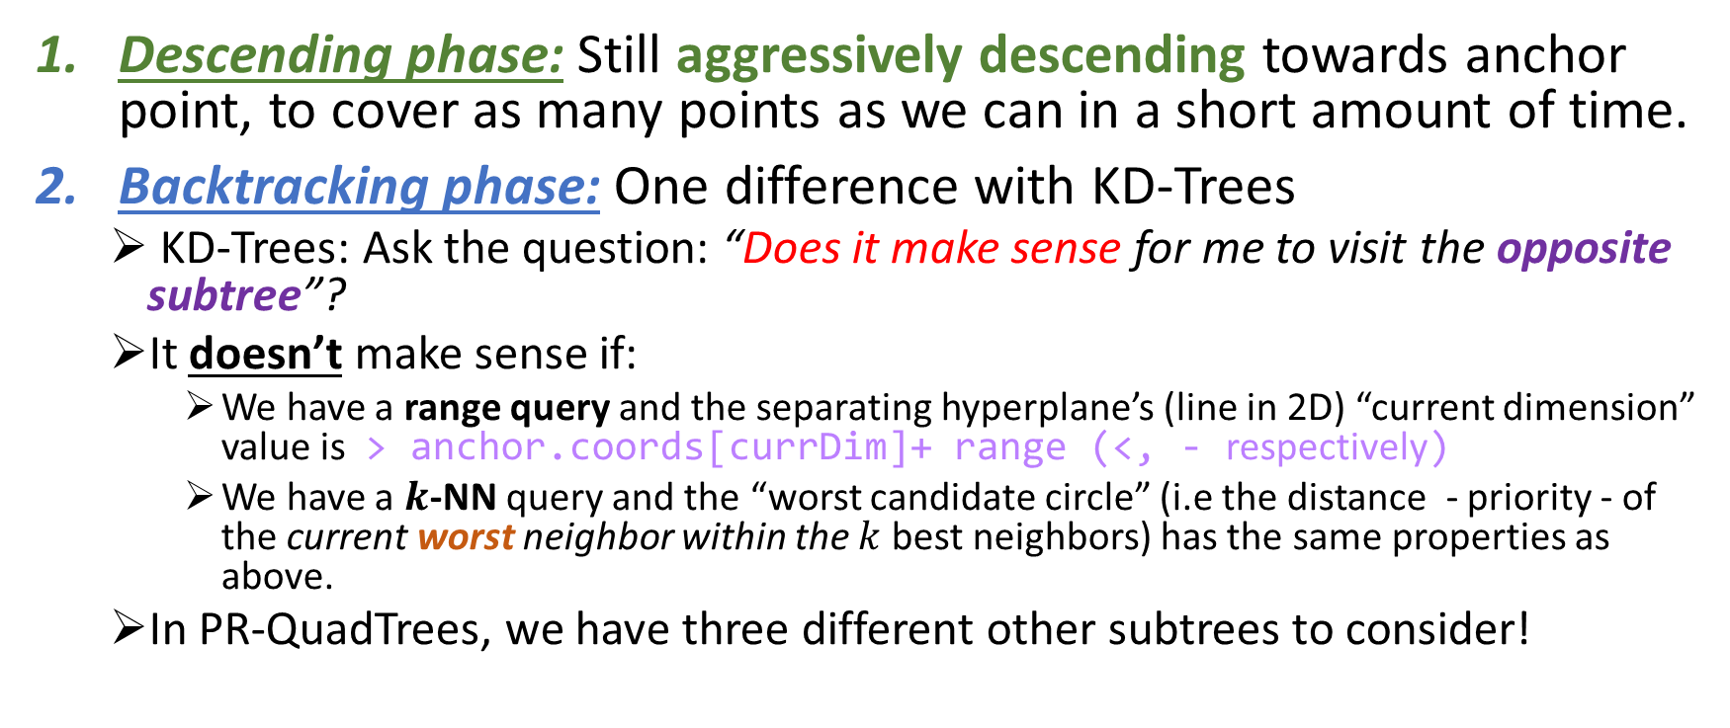
Spatial Queries in PR-Quadtrees
Descending phase: Still aggressively descending towards anchor point, to cover as many points as we can in a short amount of time.
Backtracking phase: One difference with KD-Trees
KD-Trees: Ask the question: “Does it make sense for me to visit the opposite subtree”?
It doesn’t make sense if:
We have a range query and the separating hyperplane’s (line in 2D) “current dimension” value is > anchor.coords[currDim]+ range (<, - respectively)
We have a $k$-NN query and the “worst candidate circle” (i.e the distance - priority - of the current worst neighbor within the $k$ best neighbors) has the same properties as above.
In PR-QuadTrees, we have three different other subtrees to consider!

Slide 56

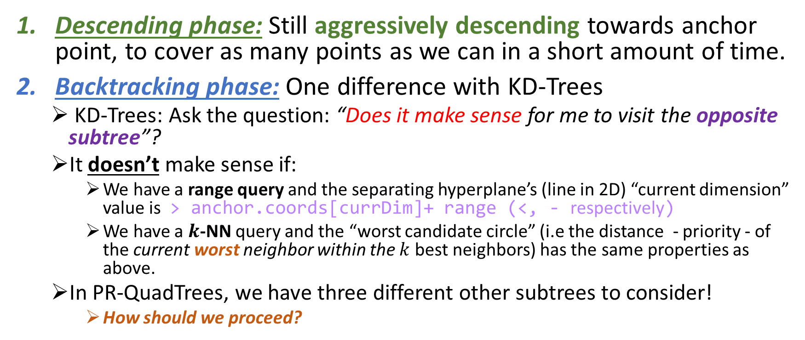
Spatial Queries in PR-Quadtrees
Descending phase: Still aggressively descending towards anchor point, to cover as many points as we can in a short amount of time.
Backtracking phase: One difference with KD-Trees
KD-Trees: Ask the question: “Does it make sense for me to visit the opposite subtree”?
It doesn’t make sense if:
We have a range query and the separating hyperplane’s (line in 2D) “current dimension” value is > anchor.coords[currDim]+ range (<, - respectively)
We have a $k$-NN query and the “worst candidate circle” (i.e the distance - priority - of the current worst neighbor within the $k$ best neighbors) has the same properties as above.
In PR-QuadTrees, we have three different other subtrees to consider!
How should we proceed?

Slide 57

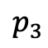
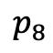


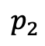
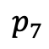

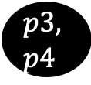

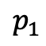
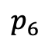
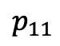

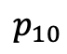
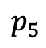

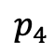
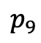

Example of range query in PR-QuadTree
anchor = (-9, 3), range $r=7$, Bucket size $b=2$
(-16, 16)
(16, 16)
$$p_{2}$$
$$p_{3}$$
$$p_{1}$$
$$p_{4}$$
$$p_{5}$$
$$p_{5}$$
$$p_{6}$$
$$p1, \\ p2$$
$$p_{7}$$
3
$$p_{8}$$
$$p3, \\ p4$$
$$p_{9}, \\ p_{10}$$
$$p_{11}$$
-9
-4
0
4
-8
8
$$p_{10}$$
$$p_{9}$$
-4
-8
$$p_{6}$$
$$p_{8}$$
$$p_{7}$$
$$p_{11}$$
(-16, -16)
(16, -16)

Slide 58

Example of range query in PR-QuadTree
anchor = (-9, 3), range $r=7$, Bucket size $b=2$
(-16, 16)
(16, 16)
$$p_{2}$$
$$p_{3}$$
$$p_{1}$$
$$p_{4}$$
$$p_{5}$$
$$p_{5}$$
$$p_{6}$$
$$p1, \\ p2$$
$$p_{7}$$
3
$$p_{8}$$
$$p3, \\ p4$$
$$p_{9}$$
$$p_{11}$$
$$p_{9}, \\ p_{10}$$
-9
-4
0
4
-8
8
$$p_{10}$$
$$p_{9}$$
-4
-8
$$p_{6}$$
$$p_{8}$$
$$p_{7}$$
$$p_{11}$$
Visit root
(-16, -16)
(16, -16)

Slide 59
Example of range query in PR-QuadTree
anchor = (-9, 3), range $r=7$, Bucket size $b=2$
(-16, 16)
(16, 16)
$$p_{2}$$
$$p_{3}$$
$$p_{1}$$
$$p_{4}$$
$$p_{5}$$
$$p_{5}$$
$$p_{6}$$
$$p1, \\ p2$$
$$p_{7}$$
3
$$p_{8}$$
$$p3, \\ p4$$
$$p_{9}$$
$$p_{11}$$
$$p_{9}, \\ p_{10}$$
-9
-4
0
4
-8
8
$$p_{10}$$
$$p_{9}$$
-4
-8
$$p_{6}$$
$$p_{8}$$
$$p_{7}$$
$$p_{11}$$
Is there a non-zero area intersection between the quadrant spanned by the root and the range?
(-16, -16)
(16, -16)

Slide 60

Example of range query in PR-QuadTree
anchor = (-9, 3), range $r=7$, Bucket size $b=2$
(-16, 16)
(16, 16)
$$p_{2}$$
$$p_{3}$$
$$p_{1}$$
$$p_{4}$$
$$p_{5}$$
$$p_{5}$$
$$p_{6}$$
$$p1, \\ p2$$
$$p_{7}$$
3
$$p_{8}$$
$$p3, \\ p4$$
$$p_{9}$$
$$p_{11}$$
$$p_{9}, \\ p_{10}$$
-9
-4
0
4
-8
8
$$p_{10}$$
$$p_{9}$$
-4
-8
$$p_{6}$$
$$p_{8}$$
$$p_{7}$$
$$p_{11}$$
Is there a non-zero area intersection between the quadrant spanned by the root and the range? YUP!
(-16, -16)
(16, -16)

Slide 61
Example of range query in PR-QuadTree
anchor = (-9, 3), range $r=7$, Bucket size $b=2$
(-16, 16)
(16, 16)
$$p_{2}$$
$$p_{3}$$
$$p_{1}$$
$$p_{4}$$
$$p_{5}$$
$$p_{5}$$
$$p_{6}$$
$$p1, \\ p2$$
$$p_{7}$$
3
$$p_{8}$$
$$p3, \\ p4$$
$$p_{9}$$
$$p_{11}$$
$$p_{9}, \\ p_{10}$$
-9
-4
0
4
-8
8
$$p_{10}$$
$$p_{9}$$
-4
-8
$$p_{6}$$
$$p_{8}$$
$$p_{7}$$
$$p_{11}$$
So it makes sense to stay in the tree, and we don’t have to return.
(-16, -16)
(16, -16)

Slide 62
Example of range query in PR-QuadTree
anchor = (-9, 3), range $r=7$, Bucket size $b=2$
(-16, 16)
(16, 16)
$$p_{2}$$
$$p_{3}$$
$$p_{1}$$
$$p_{4}$$
$$p_{5}$$
$$p_{5}$$
$$p_{6}$$
$$p1, \\ p2$$
$$p_{7}$$
3
$$p_{8}$$
$$p3, \\ p4$$
$$p_{9}$$
$$p_{11}$$
$$p_{9}, \\ p_{10}$$
-9
-4
0
4
-8
8
$$p_{10}$$
$$p_{9}$$
-4
-8
$$p_{6}$$
$$p_{8}$$
$$p_{7}$$
$$p_{11}$$
This analysis might seem stupid to do at the root of the tree, but is exactly the process that needs to happen in every subtree!
(-16, -16)
(16, -16)

Slide 63
Example of range query in PR-QuadTree
anchor = (-9, 3), range $r=7$, Bucket size $b=2$
(-16, 16)
(16, 16)
$$p_{2}$$
$$p_{3}$$
$$p_{1}$$
$$p_{4}$$
$$p_{5}$$
$$p_{5}$$
$$p_{6}$$
$$p1, \\ p2$$
$$p_{7}$$
3
$$p_{8}$$
$$p3, \\ p4$$
$$p_{9}$$
$$p_{11}$$
$$p_{9}, \\ p_{10}$$
-9
-4
0
4
-8
8
$$p_{10}$$
$$p_{9}$$
-4
-8
$$p_{6}$$
$$p_{8}$$
$$p_{7}$$
$$p_{11}$$
Greedily approach anchor point to heuristically gather as many points as you can fast. Visit first (NW) subtree.
(-16, -16)
(16, -16)

Slide 64
Example of range query in PR-QuadTree
anchor = (-9, 3), range $r=7$, Bucket size $b=2$
(-16, 16)
(16, 16)
$$p_{2}$$
$$p_{3}$$
$$p_{1}$$
$$p_{4}$$
$$p_{5}$$
$$p_{5}$$
$$p_{6}$$
$$p1, \\ p2$$
$$p_{7}$$
3
$$p_{8}$$
$$p3, \\ p4$$
$$p_{9}$$
$$p_{11}$$
$$p_{9}, \\ p_{10}$$
-9
-4
0
4
-8
8
$$p_{10}$$
$$p_{9}$$
-4
-8
$$p_{6}$$
$$p_{8}$$
$$p_{7}$$
$$p_{11}$$
Greedily approach anchor point to heuristically gather as many points as you can fast. Visit first (NW) subtree.
(-16, -16)
(16, -16)

Slide 65
Example of range query in PR-QuadTree
anchor = (-9, 3), range $r=7$, Bucket size $b=2$
(-16, 16)
(16, 16)
$$p_{2}$$
$$p_{3}$$
$$p_{1}$$
$$p_{4}$$
$$p_{5}$$
$$p_{5}$$
$$p_{6}$$
$$p1, \\ p2$$
$$p_{7}$$
3
$$p_{8}$$
$$p3, \\ p4$$
$$p_{9}$$
$$p_{11}$$
$$p_{9}, \\ p_{10}$$
-9
-4
0
4
-8
8
$$p_{10}$$
$$p_{9}$$
-4
-8
$$p_{6}$$
$$p_{8}$$
$$p_{7}$$
$$p_{11}$$
Is there a non-zero intersection between range and subtree?
(-16, -16)
(16, -16)

Slide 66

Example of range query in PR-QuadTree
anchor = (-9, 3), range $r=7$, Bucket size $b=2$
(-16, 16)
(16, 16)
$$p_{2}$$
$$p_{3}$$
$$p_{1}$$
$$p_{4}$$
$$p_{5}$$
$$p_{5}$$
$$p_{6}$$
$$p1, \\ p2$$
$$p_{7}$$
3
$$p_{8}$$
$$p3, \\ p4$$
$$p_{9}$$
$$p_{11}$$
$$p_{9}, \\ p_{10}$$
-9
-4
0
4
-8
8
$$p_{10}$$
$$p_{9}$$
-4
-8
$$p_{6}$$
$$p_{8}$$
$$p_{7}$$
$$p_{11}$$
Is there a non-zero intersection between range and subtree?
(-16, -16)
(16, -16)

Slide 67
Example of range query in PR-QuadTree
anchor = (-9, 3), range $r=7$, Bucket size $b=2$
(-16, 16)
(16, 16)
$$p_{2}$$
$$p_{3}$$
$$p_{1}$$
$$p_{4}$$
$$p_{5}$$
$$p_{5}$$
$$p_{6}$$
$$p1, \\ p2$$
$$p_{7}$$
3
$$p_{8}$$
$$p3, \\ p4$$
$$p_{9}$$
$$p_{11}$$
$$p_{9}, \\ p_{10}$$
-9
-4
0
4
-8
8
$$p_{10}$$
$$p_{9}$$
-4
-8
$$p_{6}$$
$$p_{8}$$
$$p_{7}$$
$$p_{11}$$
Aggressively approach the anchor
(-16, -16)
(16, -16)

Slide 68
Example of range query in PR-QuadTree
anchor = (-9, 3), range $r=7$, Bucket size $b=2$
(-16, 16)
(16, 16)
$$p_{2}$$
$$p_{3}$$
$$p_{1}$$
$$p_{4}$$
$$p_{5}$$
$$p_{5}$$
$$p_{6}$$
$$p1, \\ p2$$
$$p_{7}$$
3
$$p_{8}$$
$$p3, \\ p4$$
$$p_{9}$$
$$p_{11}$$
$$p_{9}, \\ p_{10}$$
-9
-4
0
4
-8
8
$$p_{10}$$
$$p_{9}$$
-4
-8
$$p_{6}$$
$$p_{8}$$
$$p_{7}$$
$$p_{11}$$
Aggressively approach the anchor.
(-16, -16)
(16, -16)

Slide 69
Example of range query in PR-QuadTree
anchor = (-9, 3), range $r=7$, Bucket size $b=2$
(-16, 16)
(16, 16)
$$p_{2}$$
$$p_{3}$$
$$p_{1}$$
$$p_{4}$$
$$p_{5}$$
$$p_{5}$$
$$p_{6}$$
$$p1, \\ p2$$
$$p_{7}$$
3
$$p_{8}$$
$$p3, \\ p4$$
$$p_{9}$$
$$p_{11}$$
$$p_{9}, \\ p_{10}$$
-9
-4
0
4
-8
8
$$p_{10}$$
$$p_{9}$$
-4
-8
$$p_{6}$$
$$p_{8}$$
$$p_{7}$$
$$p_{11}$$
While there exists a non-zero intersection, the current node is also a white node, so he can’t quite contribute to the solution!
(-16, -16)
(16, -16)

Slide 70
Example of range query in PR-QuadTree
anchor = (-9, 3), range $r=7$, Bucket size $b=2$
(-16, 16)
(16, 16)
$$p_{2}$$
$$p_{3}$$
$$p_{1}$$
$$p_{4}$$
$$p_{5}$$
$$p_{5}$$
$$p_{6}$$
$$p1, \\ p2$$
$$p_{7}$$
3
$$p_{8}$$
$$p3, \\ p4$$
$$p_{9}$$
$$p_{11}$$
$$p_{9}, \\ p_{10}$$
-9
-4
0
4
-8
8
$$p_{10}$$
$$p_{9}$$
-4
-8
$$p_{6}$$
$$p_{8}$$
$$p_{7}$$
$$p_{11}$$
Implementation detail: do I actually visit a white node first? Do I check for intersection first to have a common implementation?
(-16, -16)
(16, -16)

Slide 71
Example of range query in PR-QuadTree
anchor = (-9, 3), range $r=7$, Bucket size $b=2$
(-16, 16)
(16, 16)
$$p_{2}$$
$$p_{3}$$
$$p_{1}$$
$$p_{4}$$
$$p_{5}$$
$$p_{5}$$
$$p_{6}$$
$$p1, \\ p2$$
$$p_{7}$$
3
$$p_{8}$$
$$p3, \\ p4$$
$$p_{9}$$
$$p_{11}$$
$$p_{9}, \\ p_{10}$$
-9
-4
0
4
-8
8
$$p_{10}$$
$$p_{9}$$
-4
-8
$$p_{6}$$
$$p_{8}$$
$$p_{7}$$
$$p_{11}$$
Implementation detail: do I actually visit a white node first? Do I check for intersection first to have a common implementation?
(-16, -16)
Choice is yours!
(16, -16)

Slide 72
Example of range query in PR-QuadTree
anchor = (-9, 3), range $r=7$, Bucket size $b=2$
(-16, 16)
(16, 16)
$$p_{2}$$
$$p_{3}$$
$$p_{1}$$
$$p_{4}$$
$$p_{5}$$
$$p_{5}$$
$$p_{6}$$
$$p1, \\ p2$$
$$p_{7}$$
3
$$p_{8}$$
$$p3, \\ p4$$
$$p_{9}$$
$$p_{11}$$
$$p_{9}, \\ p_{10}$$
-9
-4
0
4
-8
8
$$p_{10}$$
$$p_{9}$$
-4
-8
$$p_{6}$$
$$p_{8}$$
$$p_{7}$$
$$p_{11}$$
Backtrack!
(-16, -16)
(16, -16)

Slide 73

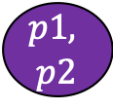
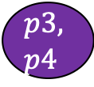
Example of range query in PR-QuadTree
anchor = (-9, 3), range $r=7$, Bucket size $b=2$
(-16, 16)
(16, 16)
$$p_{2}$$
$$p_{3}$$
$$p_{1}$$
$$p_{4}$$
$$p_{5}$$
$$p_{5}$$
$$p_{6}$$
$$p1, \\ p2$$
$$p_{7}$$
3
$$p_{8}$$
$$p3, \\ p4$$
$$p_{9}$$
$$p_{11}$$
$$p_{9}, \\ p_{10}$$
-9
-4
0
4
-8
8
$$p_{10}$$
$$p_{9}$$
-4
-8
$$p_{6}$$
$$p_{8}$$
$$p_{7}$$
$$p_{11}$$
Which other subtree do I visit first?
(-16, -16)
(16, -16)

Slide 74
Example of range query in PR-QuadTree
anchor = (-9, 3), range $r=7$, Bucket size $b=2$
(-16, 16)
(16, 16)
$$p_{2}$$
$$p_{3}$$
$$p_{1}$$
$$p_{4}$$
$$p_{5}$$
$$p_{5}$$
$$p_{6}$$
$$p1, \\ p2$$
$$p_{7}$$
3
$$p_{8}$$
$$p3, \\ p4$$
$$p_{9}$$
$$p_{11}$$
$$p_{9}, \\ p_{10}$$
-9
-4
0
4
-8
8
$$p_{10}$$
$$p_{9}$$
-4
-8
$$p_{6}$$
$$p_{8}$$
$$p_{7}$$
$$p_{11}$$
Seems as if the SE child would bear the most fruit fastest, since it has the largest area of intersection with the range…
(-16, -16)
(16, -16)

Slide 75
Example of range query in PR-QuadTree
anchor = (-9, 3), range $r=7$, Bucket size $b=2$
(-16, 16)
(16, 16)
$$p_{2}$$
$$p_{3}$$
$$p_{1}$$
$$p_{4}$$
$$p_{5}$$
$$p_{5}$$
$$p_{6}$$
$$p1, \\ p2$$
$$p_{7}$$
3
$$p_{8}$$
$$p3, \\ p4$$
$$p_{9}$$
$$p_{11}$$
$$p_{9}, \\ p_{10}$$
-9
-4
0
4
-8
8
$$p_{10}$$
$$p_{9}$$
-4
-8
$$p_{6}$$
$$p_{8}$$
$$p_{7}$$
$$p_{11}$$
BUT UNDER NO CIRCUMSTANCES WOULD WE REQUIRE THAT YOU CALCULATE THIS AREA….
(-16, -16)
(16, -16)

Slide 76
Example of range query in PR-QuadTree
anchor = (-9, 3), range $r=7$, Bucket size $b=2$
(-16, 16)
(16, 16)
1
$$p_{2}$$
2
$$p_{3}$$
$$p_{1}$$
$$p_{4}$$
$$p_{5}$$
$$p_{5}$$
1
3
$$p1, \\ p2$$
$$p_{6}$$
$$p_{7}$$
3
2
3
$$p_{8}$$
$$p3, \\ p4$$
$$p_{9}$$
$$p_{11}$$
$$p_{9}, \\ p_{10}$$
-9
-4
0
4
-8
8
$$p_{10}$$
$$p_{9}$$
-4
-8
$$p_{6}$$
$$p_{8}$$
$$p_{7}$$
$$p_{11}$$
Just do Z-order over the remaining children!
(-16, -16)
(16, -16)

Slide 77
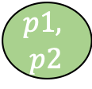
Example of range query in PR-QuadTree
anchor = (-9, 3), range $r=7$, Bucket size $b=2$
(-16, 16)
(16, 16)
1
$$p_{2}$$
2
$$p_{3}$$
$$p_{1}$$
$$p_{4}$$
$$p_{5}$$
$$p_{5}$$
1
3
$$p1, \\ p2$$
$$p_{6}$$
$$p_{7}$$
3
2
3
$$p_{8}$$
$$p3, \\ p4$$
$$p_{9}$$
$$p_{11}$$
$$p_{9}, \\ p_{10}$$
-9
-4
0
4
-8
8
$$p_{10}$$
$$p_{9}$$
-4
-8
$$p_{6}$$
$$p_{8}$$
$$p_{7}$$
$$p_{11}$$
(-16, -16)
(16, -16)

Slide 78
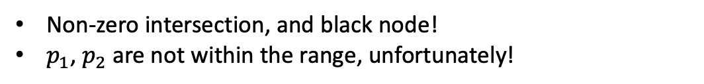
Example of range query in PR-QuadTree
anchor = (-9, 3), range $r=7$, Bucket size $b=2$
(-16, 16)
(16, 16)
1
$$p_{2}$$
2
$$p_{3}$$
$$p_{1}$$
$$p_{4}$$
$$p_{5}$$
$$p_{5}$$
1
3
$$p1, \\ p2$$
$$p_{6}$$
$$p_{7}$$
3
2
3
$$p_{8}$$
$$p3, \\ p4$$
$$p_{9}$$
$$p_{11}$$
$$p_{9}, \\ p_{10}$$
-9
-4
0
4
-8
8
$$p_{10}$$
$$p_{9}$$
-4
-8
$$p_{6}$$
$$p_{8}$$
$$p_{7}$$
$$p_{11}$$
Non-zero intersection, and black node!
$p_{1}$, $p_{2}$ are not within the range, unfortunately!
(-16, -16)
(16, -16)

Slide 79
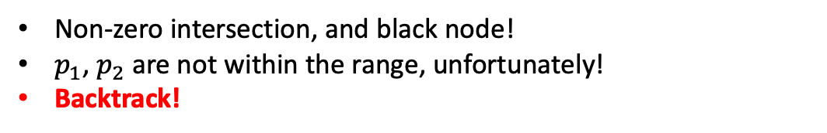
Example of range query in PR-QuadTree
anchor = (-9, 3), range $r=7$, Bucket size $b=2$
(-16, 16)
(16, 16)
1
$$p_{2}$$
2
$$p_{3}$$
$$p_{1}$$
$$p_{4}$$
$$p_{5}$$
$$p_{5}$$
1
3
$$p1, \\ p2$$
$$p_{6}$$
$$p_{7}$$
3
2
3
$$p_{8}$$
$$p3, \\ p4$$
$$p_{9}$$
$$p_{11}$$
$$p_{9}, \\ p_{10}$$
-9
-4
0
4
-8
8
$$p_{10}$$
$$p_{9}$$
-4
-8
$$p_{6}$$
$$p_{8}$$
$$p_{7}$$
$$p_{11}$$
Non-zero intersection, and black node!
$p_{1}$, $p_{2}$ are not within the range, unfortunately!
Backtrack!
(-16, -16)
(16, -16)

Slide 80
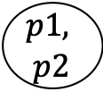
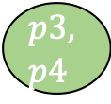
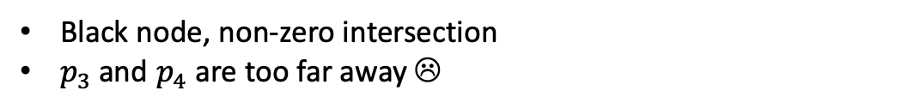
Example of range query in PR-QuadTree
anchor = (-9, 3), range $r=7$, Bucket size $b=2$
(-16, 16)
(16, 16)
1
$$p_{2}$$
2
$$p_{3}$$
$$p_{1}$$
$$p_{4}$$
$$p_{5}$$
$$p_{5}$$
1
3
$$p1, \\ p2$$
$$p_{6}$$
$$p_{7}$$
3
2
3
$$p_{8}$$
$$p3, \\ p4$$
$$p_{9}$$
$$p_{11}$$
$$p_{9}, \\ p_{10}$$
-9
-4
0
4
-8
8
$$p_{10}$$
$$p_{9}$$
-4
-8
$$p_{6}$$
$$p_{8}$$
$$p_{7}$$
$$p_{11}$$
Black node, non-zero intersection
$p_{3}$ and $p_{4}$ are too far away ☹
(-16, -16)
(16, -16)

Slide 81

Example of range query in PR-QuadTree
anchor = (-9, 3), range $r=7$, Bucket size $b=2$
(-16, 16)
(16, 16)
$$p_{2}$$
$$p_{3}$$
$$p_{1}$$
$$p_{4}$$
$$p_{5}$$
$$p_{5}$$
1
$$p_{6}$$
$$p1, \\ p2$$
$$p_{7}$$
3
2
3
$$p_{8}$$
$$p3, \\ p4$$
$$p_{9}$$
$$p_{11}$$
$$p_{9}, \\ p_{10}$$
-9
-4
0
4
-8
8
$$p_{10}$$
$$p_{9}$$
-4
-8
$$p_{6}$$
$$p_{8}$$
$$p_{7}$$
$$p_{11}$$
Non-zero intersection, but gray node!
(-16, -16)
(16, -16)

Slide 82

Example of range query in PR-QuadTree
anchor = (-9, 3), range $r=7$, Bucket size $b=2$
(-16, 16)
(16, 16)
$$p_{2}$$
$$p_{3}$$
$$p_{1}$$
$$p_{4}$$
$$p_{5}$$
$$p_{5}$$
1
$$p_{6}$$
$$p1, \\ p2$$
$$p_{7}$$
3
2
3
$$p_{8}$$
$$p3, \\ p4$$
$$p_{9}$$
$$p_{11}$$
$$p_{9}, \\ p_{10}$$
-9
-4
0
4
-8
8
$$p_{10}$$
$$p_{9}$$
-4
-8
$$p_{6}$$
$$p_{8}$$
$$p_{7}$$
$$p_{11}$$
Non-zero intersection, but gray node!
Examine child closest to anchor first!
(-16, -16)
(16, -16)

Slide 83

Example of range query in PR-QuadTree
anchor = (-9, 3), range $r=7$, Bucket size $b=2$
(-16, 16)
(16, 16)
$$p_{2}$$
$$p_{3}$$
$$p_{1}$$
$$p_{4}$$
$$p_{5}$$
$$p_{5}$$
1
$$p_{6}$$
$$p1, \\ p2$$
$$p_{7}$$
3
2
3
$$p_{8}$$
$$p3, \\ p4$$
$$p_{9}$$
$$p_{11}$$
$$p_{9}, \\ p_{10}$$
-9
-4
0
4
-8
8
$$p_{10}$$
$$p_{9}$$
-4
-8
$$p_{6}$$
$$p_{8}$$
$$p_{7}$$
$$p_{11}$$
Non-zero intersection, but gray node!
Examine child closest to anchor first!
$p_{8}$ reported ☺
(-16, -16)
(16, -16)

Slide 84

Example of range query in PR-QuadTree
anchor = (-9, 3), range $r=7$, Bucket size $b=2$
(-16, 16)
(16, 16)
$$p_{2}$$
$$p_{3}$$
$$p_{1}$$
$$p_{4}$$
$$p_{5}$$
$$p_{5}$$
1
$$p_{6}$$
$$p1, \\ p2$$
$$p_{7}$$
3
2
3
$$p_{8}$$
$$p3, \\ p4$$
$$p_{9}$$
$$p_{11}$$
$$p_{9}, \\ p_{10}$$
-9
-4
0
4
-8
8
$$p_{10}$$
$$p_{9}$$
-4
-8
$$p_{6}$$
$$p_{8}$$
$$p_{7}$$
$$p_{11}$$
Non-zero intersection, but gray node!
Examine child closest to anchor first!
$p_{8}$ reported ☺
(-16, -16)
(16, -16)

Slide 85
Example of range query in PR-QuadTree
anchor = (-9, 3), range $r=7$, Bucket size $b=2$
(-16, 16)
(16, 16)
$$p_{2}$$
$$p_{3}$$
$$p_{1}$$
$$p_{4}$$
$$p_{5}$$
$$p_{5}$$
$$p_{6}$$
$$p1, \\ p2$$
$$p_{7}$$
3
$$p_{8}$$
$$p3, \\ p4$$
$$p_{9}$$
$$p_{11}$$
$$p_{9}, \\ p_{10}$$
-9
-4
0
4
-8
8
$$p_{10}$$
$$p_{9}$$
-4
1
2
3
-8
$$p_{6}$$
$$p_{8}$$
$$p_{7}$$
$$p_{11}$$
Non-zero intersection, but gray node!
Again, do not prioritize children based on area of intersection, but on Z-order!
(-16, -16)
(16, -16)

Slide 86
Example of range query in PR-QuadTree
anchor = (-9, 3), range $r=7$, Bucket size $b=2$
(-16, 16)
(16, 16)
$$p_{2}$$
$$p_{3}$$
$$p_{1}$$
$$p_{4}$$
$$p_{5}$$
$$p_{5}$$
$$p_{6}$$
$$p1, \\ p2$$
$$p_{7}$$
3
$$p_{8}$$
$$p3, \\ p4$$
$$p_{9}$$
$$p_{11}$$
$$p_{9}, \\ p_{10}$$
-9
-4
0
4
-8
8
$$p_{10}$$
$$p_{9}$$
-4
1
2
3
-8
$$p_{6}$$
$$p_{8}$$
$$p_{7}$$
$$p_{11}$$
White node, nothing to report…
(-16, -16)
(16, -16)

Slide 87


Example of range query in PR-QuadTree
anchor = (-9, 3), range $r=7$, Bucket size $b=2$
(-16, 16)
(16, 16)
$$p_{2}$$
$$p_{3}$$
$$p_{1}$$
$$p_{4}$$
$$p_{5}$$
$$p_{5}$$
$$p_{6}$$
$$p1, \\ p2$$
$$p_{7}$$
3
$$p_{8}$$
$$p3, \\ p4$$
$$p_{9}$$
$$p_{11}$$
$$p_{9}, \\ p_{10}$$
-9
-4
0
4
-8
8
$$p_{10}$$
$$p_{9}$$
-4
1
2
3
-8
$$p_{6}$$
$$p_{8}$$
$$p_{7}$$
$$p_{11}$$
$p_{6}$ reported!
(-16, -16)
(16, -16)

Slide 88


Example of range query in PR-QuadTree
anchor = (-9, 3), range $r=7$, Bucket size $b=2$
(-16, 16)
(16, 16)
$$p_{2}$$
$$p_{3}$$
$$p_{1}$$
$$p_{4}$$
$$p_{5}$$
$$p_{5}$$
$$p_{6}$$
$$p1, \\ p2$$
$$p_{7}$$
3
$$p_{8}$$
$$p3, \\ p4$$
$$p_{9}$$
$$p_{11}$$
$$p_{9}, \\ p_{10}$$
-9
-4
0
4
-8
8
$$p_{10}$$
$$p_{9}$$
-4
1
2
3
-8
$$p_{6}$$
$$p_{8}$$
$$p_{7}$$
$$p_{11}$$
$p_{7}$ reported! (remember: range queries inclusive)
(-16, -16)
(16, -16)

Slide 89
Example of range query in PR-QuadTree
anchor = (-9, 3), range $r=7$, Bucket size $b=2$
(-16, 16)
(16, 16)
$$p_{2}$$
$$p_{3}$$
$$p_{1}$$
$$p_{4}$$
$$p_{5}$$
$$p_{5}$$
$$p_{6}$$
$$p1, \\ p2$$
$$p_{7}$$
3
$$p_{8}$$
$$p3, \\ p4$$
$$p_{9}$$
$$p_{11}$$
$$p_{9}, \\ p_{10}$$
-9
-4
0
4
-8
8
$$p_{10}$$
$$p_{9}$$
-4
-8
$$p_{6}$$
$$p_{8}$$
$$p_{7}$$
$$p_{11}$$
Backtracking all the way to the root…
(-16, -16)
(16, -16)

Slide 90
Example of range query in PR-QuadTree
anchor = (-9, 3), range $r=7$, Bucket size $b=2$
(-16, 16)
(16, 16)
$$p_{2}$$
$$p_{3}$$
$$p_{1}$$
$$p_{4}$$
$$p_{5}$$
$$p_{5}$$
$$p_{6}$$
$$p1, \\ p2$$
$$p_{7}$$
3
$$p_{8}$$
$$p3, \\ p4$$
$$p_{9}$$
$$p_{11}$$
$$p_{9}, \\ p_{10}$$
-9
-4
0
4
-8
8
$$p_{10}$$
$$p_{9}$$
-4
-8
$$p_{6}$$
$$p_{8}$$
$$p_{7}$$
$$p_{11}$$
Backtracking all the way to the root…
(-16, -16)
(16, -16)

Slide 91
Example of range query in PR-QuadTree
anchor = (-9, 3), range $r=7$, Bucket size $b=2$
(-16, 16)
(16, 16)
$$p_{2}$$
$$p_{3}$$
$$p_{1}$$
$$p_{4}$$
$$p_{5}$$
$$p_{5}$$
$$p_{6}$$
$$p1, \\ p2$$
$$p_{7}$$
3
$$p_{8}$$
$$p3, \\ p4$$
$$p_{9}$$
$$p_{11}$$
$$p_{9}, \\ p_{10}$$
-9
-4
0
4
-8
8
$$p_{10}$$
$$p_{9}$$
-4
-8
$$p_{6}$$
$$p_{8}$$
$$p_{7}$$
$$p_{11}$$
Backtracking all the way to the root…
(-16, -16)
(16, -16)

Slide 92
Example of range query in PR-QuadTree
anchor = (-9, 3), range $r=7$, Bucket size $b=2$
(-16, 16)
(16, 16)
$$p_{2}$$
$$p_{3}$$
$$p_{1}$$
$$p_{4}$$
$$p_{5}$$
$$p_{5}$$
$$p_{6}$$
$$p1, \\ p2$$
$$p_{7}$$
3
$$p_{8}$$
$$p3, \\ p4$$
$$p_{9}$$
$$p_{11}$$
$$p_{9}, \\ p_{10}$$
-9
-4
0
4
-8
8
$$p_{10}$$
$$p_{9}$$
-4
-8
$$p_{6}$$
$$p_{8}$$
$$p_{7}$$
$$p_{11}$$
Once again, examine remaining children in Z-Order!
(-16, -16)
(16, -16)

Slide 93
Example of range query in PR-QuadTree
anchor = (-9, 3), range $r=7$, Bucket size $b=2$
(-16, 16)
(16, 16)
$$p_{2}$$
3
$$p_{3}$$
1
2
$$p_{1}$$
$$p_{4}$$
$$p_{5}$$
$$p_{5}$$
$$p_{6}$$
$$p1, \\ p2$$
$$p_{7}$$
3
$$p_{8}$$
$$p3, \\ p4$$
$$p_{9}$$
$$p_{11}$$
$$p_{9}, \\ p_{10}$$
-9
-4
0
4
-8
8
$$p_{10}$$
$$p_{9}$$
-4
-8
$$p_{6}$$
$$p_{8}$$
$$p_{7}$$
$$p_{11}$$
Once again, examine remaining children in Z-Order!
(-16, -16)
(16, -16)

Slide 94

Example of range query in PR-QuadTree
anchor = (-9, 3), range $r=7$, Bucket size $b=2$
(-16, 16)
(16, 16)
$$p_{2}$$
3
$$p_{3}$$
1
2
$$p_{1}$$
$$p_{4}$$
$$p_{5}$$
$$p_{5}$$
$$p_{6}$$
$$p1, \\ p2$$
$$p_{7}$$
3
$$p_{8}$$
$$p3, \\ p4$$
$$p_{9}$$
$$p_{11}$$
$$p_{9}, \\ p_{10}$$
-9
-4
0
4
-8
8
$$p_{10}$$
$$p_{9}$$
-4
-8
$$p_{6}$$
$$p_{8}$$
$$p_{7}$$
$$p_{11}$$
Zero intersection between currently spanned quadrant and range: Subtree cannot contribute to solution set. Immediately backtrack.
(-16, -16)
(16, -16)

Slide 95
Example of range query in PR-QuadTree
anchor = (-9, 3), range $r=7$, Bucket size $b=2$
(-16, 16)
(16, 16)
$$p_{2}$$
3
$$p_{3}$$
1
2
$$p_{1}$$
$$p_{4}$$
$$p_{5}$$
$$p_{5}$$
$$p_{6}$$
$$p1, \\ p2$$
$$p_{7}$$
3
$$p_{8}$$
$$p3, \\ p4$$
$$p_{9}$$
$$p_{11}$$
$$p_{9}, \\ p_{10}$$
-9
-4
0
4
-8
8
$$p_{10}$$
$$p_{9}$$
-4
-8
$$p_{6}$$
$$p_{8}$$
$$p_{7}$$
$$p_{11}$$
Non-zero intersection between currently spanned quadrant and range!
Also, gray node
(-16, -16)
(16, -16)

Slide 96


Example of range query in PR-QuadTree
anchor = (-9, 3), range $r=7$, Bucket size $b=2$
(-16, 16)
(16, 16)
$$p_{2}$$
3
$$p_{3}$$
1
2
$$p_{1}$$
$$p_{4}$$
$$p_{5}$$
$$p_{5}$$
$$p_{6}$$
$$p1, \\ p2$$
$$p_{7}$$
3
$$p_{8}$$
$$p3, \\ p4$$
$$p_{9}$$
$$p_{11}$$
$$p_{9}, \\ p_{10}$$
-9
-4
0
4
-8
8
$$p_{10}$$
$$p_{9}$$
-4
-8
$$p_{6}$$
$$p_{8}$$
$$p_{7}$$
$$p_{11}$$
Recurse to child closest to anchor first!
That happens to be the NW child
(-16, -16)
(16, -16)

Slide 97
Example of range query in PR-QuadTree
anchor = (-9, 3), range $r=7$, Bucket size $b=2$
(-16, 16)
(16, 16)
$$p_{2}$$
3
$$p_{3}$$
1
2
$$p_{1}$$
$$p_{4}$$
$$p_{5}$$
$$p_{5}$$
$$p_{6}$$
$$p1, \\ p2$$
$$p_{7}$$
3
$$p_{8}$$
$$p3, \\ p4$$
$$p_{9}$$
$$p_{11}$$
$$p_{9}, \\ p_{10}$$
-9
-4
0
4
-8
8
$$p_{10}$$
$$p_{9}$$
-4
-8
$$p_{6}$$
$$p_{8}$$
$$p_{7}$$
$$p_{11}$$
Recurse to child closest to anchor first!
That happens to be the NW child
Non-zero intersection, black node
(-16, -16)
(16, -16)

Slide 98


Example of range query in PR-QuadTree
anchor = (-9, 3), range $r=7$, Bucket size $b=2$
(-16, 16)
(16, 16)
$$p_{2}$$
3
$$p_{3}$$
1
2
$$p_{1}$$
$$p_{4}$$
$$p_{5}$$
$$p_{5}$$
$$p_{6}$$
$$p1, \\ p2$$
$$p_{7}$$
3
$$p_{8}$$
$$p3, \\ p4$$
$$p_{9}$$
$$p_{11}$$
$$p_{9}, \\ p_{10}$$
-9
-4
0
4
-8
8
$$p_{10}$$
$$p_{9}$$
-4
-8
$$p_{6}$$
$$p_{8}$$
$$p_{7}$$
$$p_{11}$$
$p_{9}$ is within the range ☺
(-16, -16)
(16, -16)

Slide 99


Example of range query in PR-QuadTree
anchor = (-9, 3), range $r=7$, Bucket size $b=2$
(-16, 16)
(16, 16)
$$p_{2}$$
3
$$p_{3}$$
1
2
$$p_{1}$$
$$p_{4}$$
$$p_{5}$$
$$p_{5}$$
$$p_{6}$$
$$p1, \\ p2$$
$$p_{7}$$
3
$$p_{8}$$
$$p3, \\ p4$$
$$p_{9}$$
$$p_{11}$$
$$p_{9}, \\ p_{10}$$
-9
-4
0
4
-8
8
$$p_{10}$$
$$p_{9}$$
-4
-8
$$p_{6}$$
$$p_{8}$$
$$p_{7}$$
$$p_{11}$$
$p_{9}$ is within the range ☺
$p_{10}$ is not ☹
(-16, -16)
(16, -16)

Slide 100
Example of range query in PR-QuadTree
anchor = (-9, 3), range $r=7$, Bucket size $b=2$
(-16, 16)
(16, 16)
$$p_{2}$$
3
$$p_{3}$$
1
2
$$p_{1}$$
$$p_{4}$$
$$p_{5}$$
$$p_{5}$$
$$p_{6}$$
$$p1, \\ p2$$
$$p_{7}$$
3
$$p_{8}$$
$$p3, \\ p4$$
$$p_{9}$$
$$p_{11}$$
$$p_{9}, \\ p_{10}$$
-9
-4
0
4
-8
8
$$p_{10}$$
$$p_{9}$$
-4
-8
$$p_{6}$$
$$p_{8}$$
$$p_{7}$$
$$p_{11}$$
Backtrack
(-16, -16)
(16, -16)

Slide 101
Example of range query in PR-QuadTree
anchor = (-9, 3), range $r=7$, Bucket size $b=2$
(-16, 16)
(16, 16)
$$p_{2}$$
3
$$p_{3}$$
1
2
$$p_{1}$$
$$p_{4}$$
$$p_{5}$$
$$p_{5}$$
$$p_{6}$$
$$p1, \\ p2$$
$$p_{7}$$
3
$$p_{8}$$
$$p3, \\ p4$$
$$p_{9}$$
$$p_{11}$$
$$p_{9}, \\ p_{10}$$
-9
-4
0
4
-8
8
$$p_{10}$$
$$p_{9}$$
-4
-8
$$p_{6}$$
$$p_{8}$$
$$p_{7}$$
$$p_{11}$$
Loop through the rest of the children in Z-order
(-16, -16)
(16, -16)

Slide 102
Example of range query in PR-QuadTree
anchor = (-9, 3), range $r=7$, Bucket size $b=2$
(-16, 16)
(16, 16)
$$p_{2}$$
3
$$p_{3}$$
1
2
$$p_{1}$$
$$p_{4}$$
$$p_{5}$$
$$p_{5}$$
$$p_{6}$$
$$p1, \\ p2$$
3
b
c
$$p_{7}$$
a
$$p_{8}$$
$$p3, \\ p4$$
$$p_{9}$$
$$p_{11}$$
$$p_{9}, \\ p_{10}$$
-9
-4
0
4
-8
8
$$p_{10}$$
$$p_{9}$$
-4
-8
$$p_{6}$$
$$p_{8}$$
$$p_{7}$$
$$p_{11}$$
Loop through the rest of the children in Z-order
(-16, -16)
(16, -16)

Slide 103
Example of range query in PR-QuadTree
anchor = (-9, 3), range $r=7$, Bucket size $b=2$
(-16, 16)
(16, 16)
$$p_{2}$$
3
$$p_{3}$$
1
2
$$p_{1}$$
$$p_{4}$$
$$p_{5}$$
$$p_{5}$$
$$p_{6}$$
$$p1, \\ p2$$
3
b
c
$$p_{7}$$
a
$$p_{8}$$
$$p3, \\ p4$$
$$p_{9}$$
$$p_{11}$$
$$p_{9}, \\ p_{10}$$
-9
-4
0
4
-8
8
$$p_{10}$$
$$p_{9}$$
-4
-8
$$p_{6}$$
$$p_{8}$$
$$p_{7}$$
$$p_{11}$$
Non-zero intersection, but white node; no contribution to solution set.
(-16, -16)
(16, -16)

Slide 104
Example of range query in PR-QuadTree
anchor = (-9, 3), range $r=7$, Bucket size $b=2$
(-16, 16)
(16, 16)
$$p_{2}$$
3
$$p_{3}$$
1
2
$$p_{1}$$
$$p_{4}$$
$$p_{5}$$
$$p_{5}$$
$$p_{6}$$
$$p1, \\ p2$$
3
b
c
$$p_{7}$$
a
$$p_{8}$$
$$p3, \\ p4$$
$$p_{9}$$
$$p_{11}$$
$$p_{9}, \\ p_{10}$$
-9
-4
0
4
-8
8
$$p_{10}$$
$$p_{9}$$
-4
-8
$$p_{6}$$
$$p_{8}$$
$$p_{7}$$
$$p_{11}$$
Zero intersection and white node; no contribution to solution set.
(-16, -16)
(16, -16)

Slide 105

Example of range query in PR-QuadTree
anchor = (-9, 3), range $r=7$, Bucket size $b=2$
(-16, 16)
(16, 16)
$$p_{2}$$
3
$$p_{3}$$
1
2
$$p_{1}$$
$$p_{4}$$
$$p_{5}$$
$$p_{5}$$
$$p_{6}$$
$$p1, \\ p2$$
3
b
c
$$p_{7}$$
a
$$p_{8}$$
$$p3, \\ p4$$
$$p_{9}$$
$$p_{11}$$
$$p_{9}, \\ p_{10}$$
-9
-4
0
4
-8
8
$$p_{10}$$
$$p_{9}$$
-4
-8
$$p_{6}$$
$$p_{8}$$
$$p_{7}$$
$$p_{11}$$
Black node, but zero intersection ☹
Can’t contribute to solution set ☹
(-16, -16)
(16, -16)

Slide 106
Example of range query in PR-QuadTree
anchor = (-9, 3), range $r=7$, Bucket size $b=2$
(-16, 16)
(16, 16)
$$p_{2}$$
3
$$p_{3}$$
1
2
$$p_{1}$$
$$p_{4}$$
$$p_{5}$$
$$p_{5}$$
$$p_{6}$$
$$p1, \\ p2$$
$$p_{7}$$
3
$$p_{8}$$
$$p3, \\ p4$$
$$p_{9}$$
$$p_{11}$$
$$p_{9}, \\ p_{10}$$
-9
-4
0
4
-8
8
$$p_{10}$$
$$p_{9}$$
-4
-8
$$p_{6}$$
$$p_{8}$$
$$p_{7}$$
$$p_{11}$$
Backtrack to root…
(-16, -16)
(16, -16)

Slide 107
Example of range query in PR-QuadTree
anchor = (-9, 3), range $r=7$, Bucket size $b=2$
(-16, 16)
(16, 16)
$$p_{2}$$
3
$$p_{3}$$
1
2
$$p_{1}$$
$$p_{4}$$
$$p_{5}$$
$$p_{5}$$
$$p_{6}$$
$$p1, \\ p2$$
$$p_{7}$$
3
$$p_{8}$$
$$p3, \\ p4$$
$$p_{9}$$
$$p_{11}$$
$$p_{9}, \\ p_{10}$$
-9
-4
0
4
-8
8
$$p_{10}$$
$$p_{9}$$
-4
-8
$$p_{6}$$
$$p_{8}$$
$$p_{7}$$
$$p_{11}$$
Backtrack to root…
(-16, -16)
(16, -16)

Slide 108

Example of range query in PR-QuadTree
anchor = (-9, 3), range $r=7$, Bucket size $b=2$
(-16, 16)
(16, 16)
$$p_{2}$$
3
$$p_{3}$$
1
2
$$p_{1}$$
$$p_{4}$$
$$p_{5}$$
$$p_{5}$$
$$p_{6}$$
$$p1, \\ p2$$
$$p_{7}$$
3
$$p_{8}$$
$$p3, \\ p4$$
$$p_{9}$$
$$p_{11}$$
$$p_{9}, \\ p_{10}$$
-9
-4
0
4
-8
8
$$p_{10}$$
$$p_{9}$$
-4
-8
$$p_{6}$$
$$p_{8}$$
$$p_{7}$$
$$p_{11}$$
White node and beyond range: impossible to contribute to solution set!
(-16, -16)
(16, -16)

Slide 109
Example of range query in PR-QuadTree
anchor = (-9, 3), range $r=7$, Bucket size $b=2$
(-16, 16)
(16, 16)
$$p_{2}$$
3
$$p_{3}$$
1
2
$$p_{1}$$
$$p_{4}$$
$$p_{5}$$
$$p_{5}$$
$$p_{6}$$
$$p1, \\ p2$$
3
b
c
$$p_{7}$$
a
$$p_{8}$$
$$p3, \\ p4$$
$$p_{9}$$
-9
-4
0
4
-8
8
$$p_{10}$$
$$p_{9}$$
-4
-8
$$p_{6}$$
$$p_{8}$$
$$p_{7}$$
$$p_{11}$$
White node and beyond range: impossible to contribute to solution set!
Backtrack….
(-16, -16)
(16, -16)

Slide 110

Example of range query in PR-QuadTree
anchor = (-9, 3), range $r=7$, Bucket size $b=2$
(-16, 16)
(16, 16)
$$p_{2}$$
$$p_{3}$$
$$p_{1}$$
$$p_{4}$$
$$p_{5}$$
$$p_{5}$$
$$p_{6}$$
$$p1, \\ p2$$
$$p_{7}$$
3
$$p_{8}$$
$$p3, \\ p4$$
$$p_{9}$$
-9
-4
0
4
-8
8
$$p_{10}$$
$$p_{9}$$
-4
-8
$$p_{6}$$
$$p_{8}$$
$$p_{7}$$
$$p_{11}$$
White node and beyond range: impossible to contribute to solution set!
Backtrack….
Done! ☺ Solution set: $\{p_{6},p_{8},p_{7},p_{9}\}$
(-16, -16)
(16, -16)

Slide 111




















Example of $k$-NN query in PR-QuadTree
anchor = (2, 2), $k$=2, Bucket size $b=3$
(-16, 16)
(16, 16)
$$p_{2}$$
$$p_{3}$$
$$p_{12}$$
$$p_{1}$$
$$p_{4}$$
$$p_{6}$$
$$p_{5}$$
$${p_{6}, p}_{5}, \\ p_{8}$$
$$p_{7}$$
$$p_{8}$$
$$p1, \\ p2$$
$$p_{10}$$
$$p_{9}$$
2
$$p3, \\ p4$$
$$p_{11}$$
$$p_{13}$$
$$p_{14},p_{15} \\ p_{16}$$
-8
-4
0
2
4
8
$$p_{12}$$
$$p_{13}$$
-4
-8
$$p_{7}$$
$$p_{9}, \\ p_{11}$$
$$p_{10}$$
$$p_{14}$$
$$p_{15}$$
$$p_{16}$$
(-16, -16)
(16, -16)
BPQ

Slide 112
Example of $k$-NN query in PR-QuadTree
anchor = (2, 2), $k$=2, Bucket size $b=3$
(-16, 16)
(16, 16)
$$p_{2}$$
$$p_{3}$$
$$p_{12}$$
$$p_{1}$$
$$p_{4}$$
$$p_{6}$$
$$p_{5}$$
$${p_{6}, p}_{5}, \\ p_{8}$$
$$p_{7}$$
$$p_{8}$$
$$p1, \\ p2$$
$$p_{10}$$
$$p_{9}$$
2
$$p3, \\ p4$$
$$p_{11}$$
$$p_{13}$$
$$p_{14},p_{15} \\ p_{16}$$
-8
-4
0
2
4
8
$$p_{12}$$
$$p_{13}$$
-4
-8
$$p_{7}$$
$$p_{9}, \\ p_{11}$$
$$p_{10}$$
$$p_{14}$$
$$p_{15}$$
$$p_{16}$$
(-16, -16)
(16, -16)
BPQ

Slide 113
Example of $k$-NN query in PR-QuadTree
anchor = (2, 2), $k$=2, Bucket size $b=3$
(-16, 16)
(16, 16)
$$p_{2}$$
Approaching the anchor point fast might give us good bounds on our search fast!
$$p_{3}$$
$$p_{12}$$
$$p_{1}$$
$$p_{4}$$
$$p_{6}$$
$$p_{5}$$
$${p_{6}, p}_{5}, \\ p_{8}$$
$$p_{7}$$
$$p_{8}$$
$$p1, \\ p2$$
$$p_{10}$$
$$p_{9}$$
2
$$p3, \\ p4$$
$$p_{11}$$
$$p_{13}$$
$$p_{14},p_{15} \\ p_{16}$$
-8
-4
0
2
4
8
$$p_{12}$$
$$p_{13}$$
-4
-8
$$p_{7}$$
$$p_{9}, \\ p_{11}$$
$$p_{10}$$
$$p_{14}$$
$$p_{15}$$
$$p_{16}$$
(-16, -16)
(16, -16)
BPQ

Slide 114

Example of $k$-NN query in PR-QuadTree
anchor = (2, 2), $k$=2, Bucket size $b=3$
(-16, 16)
(16, 16)
$$p_{2}$$
$$p_{3}$$
$$p_{12}$$
$$p_{1}$$
$$p_{4}$$
$$p_{6}$$
$$p_{5}$$
$${p_{6}, p}_{5}, \\ p_{8}$$
$$p_{7}$$
$$p_{8}$$
$$p1, \\ p2$$
$$p_{10}$$
$$p_{9}$$
2
$$p3, \\ p4$$
$$p_{11}$$
$$p_{13}$$
$$p_{14},p_{15} \\ p_{16}$$
-8
-4
0
2
4
8
$$p_{12}$$
$$p_{13}$$
-4
-8
$$p_{7}$$
$$p_{9}, \\ p_{11}$$
$$p_{10}$$
$$p_{14}$$
$$p_{15}$$
$$p_{16}$$
(-16, -16)
(16, -16)
BPQ

Slide 115
Example of $k$-NN query in PR-QuadTree
anchor = (2, 2), $k$=2, Bucket size $b=3$
(-16, 16)
(16, 16)
$$p_{2}$$
$$p_{3}$$
$$p_{12}$$
$$p_{1}$$
$$p_{4}$$
$$p_{6}$$
$$p_{5}$$
$${p_{6}, p}_{5}, \\ p_{8}$$
$$p_{7}$$
$$p_{8}$$
$$p1, \\ p2$$
$$p_{10}$$
$$p_{9}$$
2
$$p3, \\ p4$$
$$p_{11}$$
$$p_{13}$$
$$p_{14},p_{15} \\ p_{16}$$
-8
-4
0
2
4
8
$$p_{12}$$
$$p_{13}$$
-4
-8
$$p_{7}$$
$$p_{9}, \\ p_{11}$$
$$p_{10}$$
$$p_{14}$$
$$p_{15}$$
$$p_{16}$$
(-16, -16)
(16, -16)
BPQ

Slide 116
Example of $k$-NN query in PR-QuadTree
anchor = (2, 2), $k$=2, Bucket size $b=3$
(-16, 16)
(16, 16)
$$p_{2}$$
$$p_{3}$$
$$p_{12}$$
$$p_{1}$$
$$p_{4}$$
$$p_{6}$$
$$p_{5}$$
$${p_{6}, p}_{5}, \\ p_{8}$$
$$p_{7}$$
$$p_{8}$$
$$p1, \\ p2$$
$$p_{10}$$
$$p_{9}$$
2
$$p3, \\ p4$$
$$p_{11}$$
$$p_{13}$$
$$p_{14},p_{15} \\ p_{16}$$
-8
-4
0
2
4
8
$$p_{12}$$
$$p_{13}$$
-4
-8
$$p_{7}$$
$$p_{9}, \\ p_{11}$$
$$p_{10}$$
$$p_{14}$$
$$p_{15}$$
$$p_{16}$$
(-16, -16)
(16, -16)
BPQ

Slide 117


Example of $k$-NN query in PR-QuadTree
anchor = (2, 2), $k$=2, Bucket size $b=3$
(-16, 16)
(16, 16)
$$p_{2}$$
$$p_{3}$$
$$p_{12}$$
$$p_{1}$$
$$p_{4}$$
$$p_{6}$$
$$p_{5}$$
$${p_{6}, p}_{5}, \\ p_{8}$$
$$p_{7}$$
$$p_{8}$$
$$p1, \\ p2$$
$$p_{10}$$
$$p_{9}$$
2
$$p3, \\ p4$$
$$p_{11}$$
$$p_{13}$$
$$p_{14},p_{15} \\ p_{16}$$
-8
-4
0
2
4
8
$$p_{12}$$
$$p_{13}$$
-4
-8
$$p_{7}$$
$$p_{9}, \\ p_{11}$$
$$p_{10}$$
$$p_{14}$$
$$p_{15}$$
$$p_{16}$$
$$p_{6}$$
$$p_{5}$$
BPQ
(-16, -16)
(16, -16)

Slide 118


Example of $k$-NN query in PR-QuadTree
anchor = (2, 2), $k$=2, Bucket size $b=3$
(-16, 16)
(16, 16)
$$p_{2}$$
$$p_{3}$$
$$p_{12}$$
$$p_{1}$$
$$p_{4}$$
$$p_{6}$$
$$p_{5}$$
$${p_{6}, p}_{5}, \\ p_{8}$$
$$p_{7}$$
$$p_{8}$$
$$p1, \\ p2$$
$$p_{10}$$
$$p_{9}$$
2
$$p3, \\ p4$$
$$p_{11}$$
$$p_{13}$$
$$p_{14},p_{15} \\ p_{16}$$
-8
-4
0
2
4
8
$$p_{12}$$
$$p_{13}$$
-4
-8
$$p_{7}$$
$$p_{9}, \\ p_{11}$$
$$p_{10}$$
$$p_{14}$$
$$p_{15}$$
$$p_{16}$$
$$p_{6}$$
$$p_{5}$$
BPQ
(-16, -16)
(16, -16)

Slide 119
Example of $k$-NN query in PR-QuadTree
anchor = (2, 2), $k$=2, Bucket size $b=3$
(-16, 16)
(16, 16)
$$p_{2}$$
$$p_{3}$$
$$p_{12}$$
$$p_{1}$$
$$p_{4}$$
$$p_{6}$$
$$p_{5}$$
$${p_{6}, p}_{5}, \\ p_{8}$$
$$p_{7}$$
$$p_{8}$$
$$p1, \\ p2$$
$$p_{10}$$
$$p_{9}$$
2
$$p3, \\ p4$$
$$p_{11}$$
$$p_{13}$$
$$p_{14},p_{15} \\ p_{16}$$
-8
-4
0
2
4
8
$$p_{12}$$
$$p_{13}$$
-4
-8
$$p_{7}$$
$$p_{9}, \\ p_{11}$$
$$p_{10}$$
$$p_{14}$$
$$p_{15}$$
$$p_{16}$$
Backtrack to root!
$$p_{6}$$
$$p_{5}$$
BPQ
(-16, -16)
(16, -16)

Slide 120
Example of $k$-NN query in PR-QuadTree
anchor = (2, 2), $k$=2, Bucket size $b=3$
(-16, 16)
(16, 16)
$$p_{2}$$
$$p_{3}$$
$$p_{12}$$
$$p_{1}$$
$$p_{4}$$
$$p_{6}$$
$$p_{5}$$
$${p_{6}, p}_{5}, \\ p_{8}$$
$$p_{7}$$
$$p_{8}$$
$$p1, \\ p2$$
$$p_{10}$$
$$p_{9}$$
2
$$p3, \\ p4$$
$$p_{11}$$
$$p_{13}$$
$$p_{14},p_{15} \\ p_{16}$$
-8
-4
0
2
4
8
$$p_{12}$$
$$p_{13}$$
-4
-8
$$p_{7}$$
$$p_{9}, \\ p_{11}$$
$$p_{10}$$
$$p_{14}$$
$$p_{15}$$
$$p_{16}$$
$$p_{6}$$
$$p_{5}$$
BPQ
(-16, -16)
(16, -16)

Slide 121
Example of $k$-NN query in PR-QuadTree
anchor = (2, 2), $k$=2, Bucket size $b=3$
(-16, 16)
(16, 16)
$$p_{2}$$
$$p_{3}$$
$$p_{12}$$
$$p_{1}$$
$$p_{4}$$
$$p_{6}$$
$$p_{5}$$
$${p_{6}, p}_{5}, \\ p_{8}$$
$$p_{7}$$
$$p_{8}$$
$$p1, \\ p2$$
$$p_{10}$$
$$p_{9}$$
2
$$p3, \\ p4$$
$$p_{11}$$
$$p_{13}$$
$$p_{14},p_{15} \\ p_{16}$$
-8
-4
0
2
4
8
$$p_{12}$$
$$p_{13}$$
-4
-8
$$p_{7}$$
$$p_{9}, \\ p_{11}$$
$$p_{10}$$
$$p_{14}$$
Visit remaining children in Z-order!
$$p_{15}$$
$$p_{16}$$
$$p_{6}$$
$$p_{5}$$
BPQ
(-16, -16)
(16, -16)

Slide 122
Example of $k$-NN query in PR-QuadTree
anchor = (2, 2), $k$=2, Bucket size $b=3$
(-16, 16)
(16, 16)
3
$$p_{2}$$
$$p_{3}$$
1
$$p_{12}$$
$$p_{1}$$
$$p_{4}$$
2
$$p_{6}$$
$$p_{5}$$
$${p_{6}, p}_{5}, \\ p_{8}$$
$$p_{7}$$
$$p_{8}$$
$$p1, \\ p2$$
$$p_{10}$$
$$p_{9}$$
2
$$p3, \\ p4$$
$$p_{11}$$
$$p_{13}$$
$$p_{14},p_{15} \\ p_{16}$$
-8
-4
0
2
4
8
$$p_{12}$$
$$p_{13}$$
-4
-8
$$p_{7}$$
$$p_{9}, \\ p_{11}$$
$$p_{10}$$
$$p_{14}$$
Visit remaining children in Z-order!
$$p_{15}$$
$$p_{16}$$
$$p_{6}$$
$$p_{5}$$
BPQ
(-16, -16)
(16, -16)

Slide 123
Example of $k$-NN query in PR-QuadTree
anchor = (2, 2), $k$=2, Bucket size $b=3$
(-16, 16)
(16, 16)
3
$$p_{2}$$
$$p_{3}$$
1
$$p_{12}$$
$$p_{1}$$
$$p_{4}$$
2
$$p_{6}$$
$$p_{5}$$
$${p_{6}, p}_{5}, \\ p_{8}$$
$$p_{7}$$
$$p_{8}$$
$$p1, \\ p2$$
$$p_{10}$$
$$p_{9}$$
2
$$p3, \\ p4$$
$$p_{11}$$
$$p_{13}$$
$$p_{14},p_{15} \\ p_{16}$$
-8
-4
0
2
4
8
$$p_{12}$$
$$p_{13}$$
-4
-8
$$p_{7}$$
$$p_{9}, \\ p_{11}$$
$$p_{10}$$
$$p_{14}$$
$$p_{15}$$
$$p_{16}$$
$$p_{6}$$
$$p_{5}$$
BPQ
(-16, -16)
(16, -16)

Slide 124
Example of $k$-NN query in PR-QuadTree
anchor = (2, 2), $k$=2, Bucket size $b=3$
(-16, 16)
(16, 16)
3
$$p_{2}$$
$$p_{3}$$
1
$$p_{12}$$
$$p_{1}$$
$$p_{4}$$
2
$$p_{6}$$
$$p_{5}$$
$${p_{6}, p}_{5}, \\ p_{8}$$
$$p_{7}$$
$$p_{8}$$
$$p1, \\ p2$$
$$p_{10}$$
$$p_{9}$$
2
$$p3, \\ p4$$
$$p_{11}$$
$$p_{13}$$
$$p_{14},p_{15} \\ p_{16}$$
-8
-4
0
2
4
8
$$p_{12}$$
$$p_{13}$$
-4
Foreshadowing: Far NW quadrant won’t even be visited because of established tight bounds!
-8
$$p_{7}$$
$$p_{9}, \\ p_{11}$$
$$p_{10}$$
$$p_{14}$$
$$p_{15}$$
$$p_{16}$$
$$p_{6}$$
$$p_{5}$$
BPQ
(-16, -16)
(16, -16)

Slide 125
Example of $k$-NN query in PR-QuadTree
anchor = (2, 2), $k$=2, Bucket size $b=3$
(-16, 16)
(16, 16)
3
$$p_{2}$$
$$p_{3}$$
1
$$p_{12}$$
$$p_{1}$$
$$p_{4}$$
2
$$p_{6}$$
$$p_{5}$$
$${p_{6}, p}_{5}, \\ p_{8}$$
$$p_{7}$$
$$p_{8}$$
$$p1, \\ p2$$
$$p_{10}$$
$$p_{9}$$
2
$$p3, \\ p4$$
$$p_{11}$$
$$p_{13}$$
$$p_{14},p_{15} \\ p_{16}$$
-8
-4
0
2
4
8
$$p_{12}$$
$$p_{13}$$
-4
-8
$$p_{9}, \\ p_{11}$$
Again, aggressively branch towards the anchor to bound the solution above fast!
$$p_{7}$$
$$p_{10}$$
$$p_{14}$$
$$p_{15}$$
$$p_{16}$$
$$p_{6}$$
$$p_{5}$$
BPQ
(-16, -16)
(16, -16)

Slide 126
Example of $k$-NN query in PR-QuadTree
anchor = (2, 2), $k$=2, Bucket size $b=3$
(-16, 16)
(16, 16)
3
$$p_{2}$$
$$p_{3}$$
1
$$p_{12}$$
$$p_{1}$$
$$p_{4}$$
2
$$p_{6}$$
$$p_{5}$$
$${p_{6}, p}_{5}, \\ p_{8}$$
$$p_{7}$$
$$p_{8}$$
$$p1, \\ p2$$
$$p_{10}$$
$$p_{9}$$
2
$$p3, \\ p4$$
$$p_{11}$$
$$p_{13}$$
$$p_{14},p_{15} \\ p_{16}$$
-8
-4
0
2
4
8
$$p_{12}$$
$$p_{13}$$
-4
-8
$$p_{7}$$
$$p_{9}, \\ p_{11}$$
$$p_{10}$$
$$p_{14}$$
$$p_{15}$$
$$p_{16}$$
$$p_{6}$$
$$p_{5}$$
BPQ
(-16, -16)
(16, -16)

Slide 127

Example of $k$-NN query in PR-QuadTree
anchor = (2, 2), $k$=2, Bucket size $b=3$
(-16, 16)
(16, 16)
3
$$p_{2}$$
$$p_{3}$$
1
$$p_{12}$$
$$p_{1}$$
$$p_{4}$$
2
$$p_{6}$$
$$p_{5}$$
$${p_{6}, p}_{5}, \\ p_{8}$$
$$p_{7}$$
$$p_{8}$$
$$p1, \\ p2$$
$$p_{10}$$
$$p_{9}$$
2
$$p3, \\ p4$$
$$p_{11}$$
$$p_{13}$$
$$p_{14},p_{15} \\ p_{16}$$
-8
-4
0
2
4
8
$$p_{12}$$
$$p_{13}$$
-4
-8
$$p_{7}$$
$$p_{9}, \\ p_{11}$$
$$p_{10}$$
$$p_{14}$$
$$p_{15}$$
$$p_{16}$$
$$p_{6}$$
$$p_{5}$$
BPQ
(-16, -16)
(16, -16)

Slide 128



Example of $k$-NN query in PR-QuadTree
anchor = (2, 2), $k$=2, Bucket size $b=3$
(-16, 16)
(16, 16)
3
$$p_{2}$$
$$p_{3}$$
1
$$p_{12}$$
$$p_{1}$$
$$p_{4}$$
2
$$p_{6}$$
$$p_{5}$$
$${p_{6}, p}_{5}, \\ p_{8}$$
$$p_{7}$$
$$p_{8}$$
$$p1, \\ p2$$
$$p_{10}$$
$$p_{9}$$
2
$$p3, \\ p4$$
$$p_{11}$$
$$p_{13}$$
$$p_{14},p_{15} \\ p_{16}$$
-8
-4
0
2
4
8
$$p_{12}$$
$$p_{13}$$
-4
-8
$$p_{7}$$
$$p_{9}, \\ p_{11}$$
$$p_{10}$$
$$p_{14}$$
$$p_{15}$$
$p_{9}$ improves upon $p_{6}!$ New best neighbor!
$$p_{16}$$
(-16, -16)
(16, -16)
$$p_{9}$$
$$p_{6}$$
BPQ

Slide 129


Example of $k$-NN query in PR-QuadTree
anchor = (2, 2), $k$=2, Bucket size $b=3$
(-16, 16)
(16, 16)
3
$$p_{2}$$
$$p_{3}$$
1
$$p_{12}$$
$$p_{1}$$
$$p_{4}$$
2
$$p_{6}$$
$$p_{5}$$
$${p_{6}, p}_{5}, \\ p_{8}$$
$$p_{7}$$
$$p_{8}$$
$$p1, \\ p2$$
$$p_{10}$$
$$p_{9}$$
2
$$p3, \\ p4$$
$$p_{11}$$
$$p_{13}$$
$$p_{14},p_{15} \\ p_{16}$$
-8
-4
0
2
4
8
$$p_{12}$$
$$p_{13}$$
-4
-8
$$p_{7}$$
$$p_{9}, \\ p_{11}$$
$$p_{10}$$
$$p_{14}$$
$$p_{15}$$
What about $p_{11}$?
$$p_{16}$$
(-16, -16)
(16, -16)
$$p_{9}$$
$$p_{6}$$
BPQ

Slide 130


Example of $k$-NN query in PR-QuadTree
anchor = (2, 2), $k$=2, Bucket size $b=3$
(-16, 16)
(16, 16)
3
$$p_{2}$$
$$p_{3}$$
1
$$p_{12}$$
$$p_{1}$$
$$p_{4}$$
2
$$p_{6}$$
$$p_{5}$$
$${p_{6}, p}_{5}, \\ p_{8}$$
$$p_{7}$$
$$p_{8}$$
$$p1, \\ p2$$
$$p_{10}$$
$$p_{9}$$
2
$$p3, \\ p4$$
$$p_{11}$$
$$p_{13}$$
$$p_{14},p_{15} \\ p_{16}$$
-8
-4
0
2
4
8
$$p_{12}$$
$$p_{13}$$
-4
-8
$$p_{7}$$
$$p_{9}, \\ p_{11}$$
$$p_{10}$$
$$p_{14}$$
$$p_{15}$$
What about $p_{11}$?
$$p_{16}$$
(-16, -16)
(16, -16)
$$p_{9}$$
$$p_{6}$$
BPQ
Since it has the same “priority” as $p_{6}$, we do not insert it! $p_{6}$ is now our second-best neighbor!

Slide 131

Example of $k$-NN query in PR-QuadTree
anchor = (2, 2), $k$=2, Bucket size $b=3$
(-16, 16)
(16, 16)
3
$$p_{2}$$
$$p_{3}$$
1
$$p_{12}$$
$$p_{1}$$
$$p_{4}$$
2
$$p_{6}$$
$$p_{5}$$
$${p_{6}, p}_{5}, \\ p_{8}$$
$$p_{7}$$
$$p_{8}$$
$$p1, \\ p2$$
$$p_{10}$$
$$p_{9}$$
2
$$p3, \\ p4$$
$$p_{11}$$
$$p_{13}$$
$$p_{14},p_{15} \\ p_{16}$$
-8
-4
0
2
4
8
$$p_{12}$$
$$p_{13}$$
-4
-8
$$p_{7}$$
$$p_{9}, \\ p_{11}$$
$$p_{10}$$
$$p_{14}$$
$$p_{15}$$
$$p_{16}$$
(-16, -16)
(16, -16)
$$p_{9}$$
$$p_{6}$$
BPQ

Slide 132
Example of $k$-NN query in PR-QuadTree
anchor = (2, 2), $k$=2, Bucket size $b=3$
(-16, 16)
(16, 16)
3
$$p_{2}$$
$$p_{3}$$
1
$$p_{12}$$
$$p_{1}$$
$$p_{4}$$
2
$$p_{6}$$
$$p_{5}$$
$${p_{6}, p}_{5}, \\ p_{8}$$
$$p_{7}$$
$$p_{8}$$
$$p1, \\ p2$$
$$p_{10}$$
$$p_{9}$$
2
$$p3, \\ p4$$
$$p_{11}$$
$$p_{13}$$
$$p_{14},p_{15} \\ p_{16}$$
-8
-4
0
2
4
8
$$p_{12}$$
$$p_{13}$$
-4
1
2
3
-8
$$p_{7}$$
$$p_{9}, \\ p_{11}$$
$$p_{10}$$
$$p_{14}$$
$$p_{15}$$
$$p_{16}$$
(-16, -16)
(16, -16)
$$p_{9}$$
$$p_{6}$$
BPQ

Slide 133
Example of $k$-NN query in PR-QuadTree
anchor = (2, 2), $k$=2, Bucket size $b=3$
(-16, 16)
(16, 16)
3
$$p_{2}$$
$$p_{3}$$
1
$$p_{12}$$
$$p_{1}$$
$$p_{4}$$
2
$$p_{6}$$
$$p_{5}$$
$${p_{6}, p}_{5}, \\ p_{8}$$
$$p_{7}$$
$$p_{8}$$
$$p1, \\ p2$$
$$p_{10}$$
$$p_{9}$$
2
$$p3, \\ p4$$
$$p_{11}$$
$$p_{13}$$
$$p_{14},p_{15} \\ p_{16}$$
-8
-4
0
2
4
8
$$p_{12}$$
$$p_{13}$$
-4
1
2
3
-8
Quadrant out of bounds! Won’t even search!
$$p_{9}, \\ p_{11}$$
$$p_{7}$$
$$p_{10}$$
$$p_{14}$$
$$p_{15}$$
$$p_{16}$$
(-16, -16)
(16, -16)
$$p_{9}$$
$$p_{6}$$
BPQ

Slide 134


Example of $k$-NN query in PR-QuadTree
anchor = (2, 2), $k$=2, Bucket size $b=3$
(-16, 16)
(16, 16)
3
$$p_{2}$$
$$p_{3}$$
1
$$p_{12}$$
$$p_{1}$$
$$p_{4}$$
2
$$p_{6}$$
$$p_{5}$$
$${p_{6}, p}_{5}, \\ p_{8}$$
$$p_{7}$$
$$p_{8}$$
$$p1, \\ p2$$
$$p_{10}$$
$$p_{9}$$
2
$$p3, \\ p4$$
$$p_{11}$$
$$p_{13}$$
$$p_{14},p_{15} \\ p_{16}$$
-8
-4
0
2
4
8
$$p_{12}$$
$$p_{13}$$
-4
Quadrant within bounds (at least partially), but $p_{7}$ scores even worse than “worse” neighbor, and queue is full, so we don’t enqueue it anywhere!
1
2
3
-8
$$p_{7}$$
$$p_{9}, \\ p_{11}$$
$$p_{10}$$
$$p_{14}$$
$$p_{15}$$
$$p_{16}$$
(-16, -16)
(16, -16)
$$p_{9}$$
$$p_{6}$$
BPQ

Slide 135



Example of $k$-NN query in PR-QuadTree
anchor = (2, 2), $k$=2, Bucket size $b=3$
(-16, 16)
(16, 16)
3
$$p_{2}$$
$$p_{3}$$
1
$$p_{12}$$
$$p_{1}$$
$$p_{4}$$
2
$$p_{6}$$
$$p_{5}$$
$${p_{6}, p}_{5}, \\ p_{8}$$
$$p_{7}$$
$$p_{8}$$
$$p1, \\ p2$$
$$p_{10}$$
$$p_{9}$$
2
$$p3, \\ p4$$
$$p_{11}$$
$$p_{13}$$
$$p_{14},p_{15} \\ p_{16}$$
-8
-4
0
2
4
8
$$p_{12}$$
$$p_{13}$$
-4
1
2
3
-8
$$p_{7}$$
$$p_{9}, \\ p_{11}$$
$$p_{10}$$
$$p_{14}$$
$$p_{15}$$
$$p_{16}$$
(-16, -16)
(16, -16)
$$p_{9}$$
$$p_{6}$$
BPQ

Slide 136

Example of $k$-NN query in PR-QuadTree
anchor = (2, 2), $k$=2, Bucket size $b=3$
(-16, 16)
(16, 16)
3
$$p_{2}$$
$$p_{3}$$
1
$$p_{12}$$
$$p_{1}$$
$$p_{4}$$
2
$$p_{6}$$
$$p_{5}$$
$${p_{6}, p}_{5}, \\ p_{8}$$
$$p_{7}$$
$$p_{8}$$
$$p1, \\ p2$$
$$p_{10}$$
$$p_{9}$$
2
$$p3, \\ p4$$
$$p_{11}$$
$$p_{13}$$
$$p_{14},p_{15} \\ p_{16}$$
-8
-4
0
2
4
8
$$p_{12}$$
$$p_{13}$$
-4
-8
$$p_{7}$$
$$p_{9}, \\ p_{11}$$
$$p_{10}$$
$$p_{14}$$
$$p_{15}$$
$$p_{16}$$
(-16, -16)
(16, -16)
$$p_{9}$$
$$p_{6}$$
BPQ

Slide 137
Example of $k$-NN query in PR-QuadTree
anchor = (2, 2), $k$=2, Bucket size $b=3$
(-16, 16)
(16, 16)
3
$$p_{2}$$
$$p_{3}$$
1
$$p_{12}$$
$$p_{1}$$
$$p_{4}$$
2
$$p_{6}$$
$$p_{5}$$
$${p_{6}, p}_{5}, \\ p_{8}$$
$$p_{7}$$
$$p_{8}$$
$$p1, \\ p2$$
$$p_{10}$$
$$p_{9}$$
2
$$p3, \\ p4$$
$$p_{11}$$
$$p_{13}$$
$$p_{14},p_{15} \\ p_{16}$$
-8
-4
0
2
4
8
$$p_{12}$$
$$p_{13}$$
-4
-8
$$p_{7}$$
$$p_{9}, \\ p_{11}$$
$$p_{10}$$
$$p_{14}$$
$$p_{15}$$
$$p_{16}$$
(-16, -16)
(16, -16)
$$p_{9}$$
$$p_{6}$$
BPQ

Slide 138
Example of $k$-NN query in PR-QuadTree
anchor = (2, 2), $k$=2, Bucket size $b=3$
(-16, 16)
(16, 16)
3
$$p_{2}$$
$$p_{3}$$
1
$$p_{12}$$
$$p_{1}$$
$$p_{4}$$
2
$$p_{6}$$
$$p_{5}$$
1
$${p_{6}, p}_{5}, \\ p_{8}$$
$$p_{7}$$
$$p_{8}$$
$$p1, \\ p2$$
2
3
$$p_{10}$$
$$p_{9}$$
2
$$p3, \\ p4$$
$$p_{11}$$
$$p_{13}$$
$$p_{14},p_{15} \\ p_{16}$$
-8
-4
0
2
4
8
$$p_{12}$$
$$p_{13}$$
-4
-8
$$p_{7}$$
$$p_{9}, \\ p_{11}$$
$$p_{10}$$
$$p_{14}$$
$$p_{15}$$
$$p_{16}$$
(-16, -16)
(16, -16)
$$p_{9}$$
$$p_{6}$$
BPQ

Slide 139


Example of $k$-NN query in PR-QuadTree
anchor = (2, 2), $k$=2, Bucket size $b=3$
(-16, 16)
(16, 16)
3
$$p_{2}$$
$$p_{3}$$
1
$$p_{12}$$
$$p_{1}$$
$$p_{4}$$
2
$$p_{6}$$
$$p_{5}$$
1
$${p_{6}, p}_{5}, \\ p_{8}$$
$$p_{7}$$
$$p_{8}$$
$$p1, \\ p2$$
2
3
$$p_{10}$$
$$p_{9}$$
2
$$p3, \\ p4$$
$$p_{11}$$
$$p_{13}$$
$$p_{14},p_{15} \\ p_{16}$$
-8
-4
0
2
4
8
$$p_{12}$$
$$p_{13}$$
-4
-8
$$p_{7}$$
$$p_{9}, \\ p_{11}$$
$$p_{10}$$
$$p_{14}$$
$$p_{15}$$
$$p_{16}$$
(-16, -16)
(16, -16)
$$p_{9}$$
$$p_{6}$$
BPQ

Slide 140



Example of $k$-NN query in PR-QuadTree
anchor = (2, 2), $k$=2, Bucket size $b=3$
(-16, 16)
(16, 16)
3
$$p_{2}$$
$$p_{3}$$
1
$$p_{12}$$
$$p_{1}$$
$$p_{4}$$
2
$$p_{6}$$
$$p_{5}$$
1
$${p_{6}, p}_{5}, \\ p_{8}$$
$$p_{7}$$
$$p_{8}$$
$$p1, \\ p2$$
2
3
$$p_{10}$$
$$p_{9}$$
2
$$p3, \\ p4$$
$$p_{11}$$
$$p_{13}$$
$$p_{14},p_{15} \\ p_{16}$$
-8
-4
0
2
4
8
$$p_{12}$$
$$p_{13}$$
-4
-8
$$p_{7}$$
$$p_{9}, \\ p_{11}$$
$$p_{10}$$
$$p_{14}$$
$$p_{15}$$
$$p_{16}$$
(-16, -16)
(16, -16)
$$p_{9}$$
$$p_{6}$$
BPQ

Slide 141

Example of $k$-NN query in PR-QuadTree
anchor = (2, 2), $k$=2, Bucket size $b=3$
(-16, 16)
(16, 16)
3
$$p_{2}$$
$$p_{3}$$
1
$$p_{12}$$
$$p_{1}$$
$$p_{4}$$
2
$$p_{6}$$
$$p_{5}$$
1
$${p_{6}, p}_{5}, \\ p_{8}$$
$$p_{7}$$
$$p_{8}$$
$$p1, \\ p2$$
2
3
$$p_{10}$$
$$p_{9}$$
2
$$p3, \\ p4$$
$$p_{11}$$
$$p_{13}$$
$$p_{14},p_{15} \\ p_{16}$$
-8
-4
0
2
4
8
$$p_{12}$$
$$p_{13}$$
-4
-8
NOOOOPE. Also, you’re a white node, so you couldn’t contribute anyway.
$$p_{9}, \\ p_{11}$$
$$p_{7}$$
$$p_{10}$$
$$p_{14}$$
$$p_{15}$$
$$p_{16}$$
(-16, -16)
(16, -16)
$$p_{9}$$
$$p_{6}$$
BPQ

Slide 142
Example of $k$-NN query in PR-QuadTree
anchor = (2, 2), $k$=2, Bucket size $b=3$
(-16, 16)
(16, 16)
3
$$p_{2}$$
$$p_{3}$$
1
$$p_{12}$$
$$p_{1}$$
$$p_{4}$$
2
$$p_{6}$$
$$p_{5}$$
$${p_{6}, p}_{5}, \\ p_{8}$$
$$p_{7}$$
$$p_{8}$$
$$p1, \\ p2$$
$$p_{10}$$
$$p_{9}$$
2
$$p3, \\ p4$$
$$p_{11}$$
$$p_{13}$$
$$p_{14},p_{15} \\ p_{16}$$
-8
-4
0
2
4
8
$$p_{12}$$
$$p_{13}$$
-4
-8
$$p_{7}$$
$$p_{9}, \\ p_{11}$$
$$p_{10}$$
$$p_{14}$$
$$p_{15}$$
$$p_{16}$$
(-16, -16)
(16, -16)
$$p_{9}$$
$$p_{6}$$
BPQ

Slide 143
Example of $k$-NN query in PR-QuadTree
anchor = (2, 2), $k$=2, Bucket size $b=3$
(-16, 16)
(16, 16)
3
$$p_{2}$$
$$p_{3}$$
1
$$p_{12}$$
$$p_{1}$$
$$p_{4}$$
2
$$p_{6}$$
$$p_{5}$$
$${p_{6}, p}_{5}, \\ p_{8}$$
$$p_{7}$$
$$p_{8}$$
$$p1, \\ p2$$
$$p_{10}$$
$$p_{9}$$
2
$$p3, \\ p4$$
$$p_{11}$$
$$p_{13}$$
$$p_{14},p_{15} \\ p_{16}$$
-8
-4
0
2
4
8
$$p_{12}$$
$$p_{13}$$
-4
-8
$$p_{7}$$
$$p_{9}, \\ p_{11}$$
$$p_{10}$$
$$p_{14}$$
$$p_{15}$$
$$p_{16}$$
(-16, -16)
(16, -16)
$$p_{9}$$
$$p_{6}$$
BPQ

Slide 144
Example of $k$-NN query in PR-QuadTree
anchor = (2, 2), $k$=2, Bucket size $b=3$
(-16, 16)
(16, 16)
3
$$p_{2}$$
$$p_{3}$$
1
$$p_{12}$$
$$p_{1}$$
$$p_{4}$$
2
$$p_{6}$$
$$p_{5}$$
$${p_{6}, p}_{5}, \\ p_{8}$$
$$p_{7}$$
$$p_{8}$$
$$p1, \\ p2$$
$$p_{10}$$
$$p_{9}$$
2
$$p3, \\ p4$$
$$p_{11}$$
$$p_{13}$$
$$p_{14},p_{15} \\ p_{16}$$
-8
-4
0
2
4
8
$$p_{12}$$
$$p_{13}$$
-4
Aggressively approaching
anchor point ….
-8
$$p_{7}$$
$$p_{9}, \\ p_{11}$$
$$p_{10}$$
$$p_{14}$$
$$p_{15}$$
$$p_{16}$$
(-16, -16)
(16, -16)
$$p_{9}$$
$$p_{6}$$
BPQ

Slide 145
Example of $k$-NN query in PR-QuadTree
anchor = (2, 2), $k$=2, Bucket size $b=3$
(-16, 16)
(16, 16)
3
$$p_{2}$$
$$p_{3}$$
1
$$p_{12}$$
$$p_{1}$$
$$p_{4}$$
2
$$p_{6}$$
$$p_{5}$$
$${p_{6}, p}_{5}, \\ p_{8}$$
$$p_{7}$$
$$p_{8}$$
$$p1, \\ p2$$
$$p_{10}$$
$$p_{9}$$
2
$$p3, \\ p4$$
$$p_{11}$$
$$p_{13}$$
$$p_{14},p_{15} \\ p_{16}$$
-8
-4
0
2
4
8
$$p_{12}$$
$$p_{13}$$
-4
Aggressively approaching
anchor point …. … even though in this case we hit a white node =/
-8
$$p_{7}$$
$$p_{9}, \\ p_{11}$$
$$p_{10}$$
$$p_{14}$$
$$p_{15}$$
$$p_{16}$$
(-16, -16)
(16, -16)
$$p_{9}$$
$$p_{6}$$
BPQ

Slide 146
Example of $k$-NN query in PR-QuadTree
anchor = (2, 2), $k$=2, Bucket size $b=3$
(-16, 16)
(16, 16)
3
$$p_{2}$$
$$p_{3}$$
1
$$p_{12}$$
$$p_{1}$$
$$p_{4}$$
2
$$p_{6}$$
$$p_{5}$$
$${p_{6}, p}_{5}, \\ p_{8}$$
$$p_{7}$$
$$p_{8}$$
$$p1, \\ p2$$
$$p_{10}$$
$$p_{9}$$
2
$$p3, \\ p4$$
$$p_{11}$$
$$p_{13}$$
$$p_{14},p_{15} \\ p_{16}$$
-8
-4
0
2
4
8
$$p_{12}$$
$$p_{13}$$
-4
-8
$$p_{7}$$
$$p_{9}, \\ p_{11}$$
$$p_{10}$$
$$p_{14}$$
$$p_{15}$$
$$p_{16}$$
(-16, -16)
(16, -16)
$$p_{9}$$
$$p_{6}$$
BPQ

Slide 147
Example of $k$-NN query in PR-QuadTree
anchor = (2, 2), $k$=2, Bucket size $b=3$
(-16, 16)
(16, 16)
3
$$p_{2}$$
$$p_{3}$$
1
$$p_{12}$$
$$p_{1}$$
$$p_{4}$$
2
$$p_{6}$$
$$p_{5}$$
$${p_{6}, p}_{5}, \\ p_{8}$$
$$p_{7}$$
$$p_{8}$$
$$p1, \\ p2$$
3
$$p_{9}$$
2
1
2
$$p_{10}$$
$$p3, \\ p4$$
$$p_{13}$$
-8
-4
$$p_{11}$$
0
2
4
8
$$p_{14},p_{15} \\ p_{16}$$
$$p_{12}$$
$$p_{13}$$
-4
-8
$$p_{7}$$
$$p_{9}, \\ p_{11}$$
$$p_{10}$$
$$p_{14}$$
$$p_{15}$$
$$p_{16}$$
(-16, -16)
(16, -16)
$$p_{9}$$
$$p_{6}$$
BPQ

Slide 148


Example of $k$-NN query in PR-QuadTree
anchor = (2, 2), $k$=2, Bucket size $b=3$
(-16, 16)
(16, 16)
3
$$p_{2}$$
$$p_{3}$$
1
$$p_{12}$$
$$p_{1}$$
$$p_{4}$$
2
$$p_{6}$$
$$p_{5}$$
$${p_{6}, p}_{5}, \\ p_{8}$$
$$p_{7}$$
$$p_{8}$$
$$p1, \\ p2$$
3
$$p_{9}$$
2
1
2
$$p_{10}$$
$$p3, \\ p4$$
$$p_{13}$$
-8
-4
$$p_{11}$$
0
2
4
8
$$p_{14},p_{15} \\ p_{16}$$
$$p_{12}$$
$$p_{13}$$
-4
None of these are close enough to contribute to the range, so let’s skip through them fast….
-8
$$p_{7}$$
$$p_{9}, \\ p_{11}$$
$$p_{10}$$
$$p_{14}$$
$$p_{15}$$
$$p_{16}$$
(-16, -16)
(16, -16)
BPQ

Slide 149


Example of $k$-NN query in PR-QuadTree
anchor = (2, 2), $k$=2, Bucket size $b=3$
(-16, 16)
(16, 16)
3
$$p_{2}$$
$$p_{3}$$
1
$$p_{12}$$
$$p_{1}$$
$$p_{4}$$
2
$$p_{6}$$
$$p_{5}$$
$${p_{6}, p}_{5}, \\ p_{8}$$
$$p_{7}$$
$$p_{8}$$
$$p1, \\ p2$$
$$p_{10}$$
$$p_{9}$$
2
$$p3, \\ p4$$
$$p_{11}$$
$$p_{13}$$
$$p_{14},p_{15} \\ p_{16}$$
-8
-4
0
2
4
8
$$p_{12}$$
$$p_{13}$$
-4
-8
$$p_{7}$$
$$p_{9}, \\ p_{11}$$
$$p_{10}$$
$$p_{14}$$
$$p_{15}$$
$$p_{16}$$
(-16, -16)
(16, -16)
$$p_{9}$$
$$p_{6}$$
BPQ

Slide 150
Example of $k$-NN query in PR-QuadTree
anchor = (2, 2), $k$=2, Bucket size $b=3$
(-16, 16)
(16, 16)
3
$$p_{2}$$
$$p_{3}$$
1
$$p_{12}$$
$$p_{1}$$
$$p_{4}$$
2
$$p_{6}$$
$$p_{5}$$
$${p_{6}, p}_{5}, \\ p_{8}$$
$$p_{7}$$
$$p_{8}$$
$$p1, \\ p2$$
$$p_{10}$$
$$p_{9}$$
2
$$p3, \\ p4$$
$$p_{11}$$
$$p_{13}$$
$$p_{14},p_{15} \\ p_{16}$$
-8
-4
0
2
4
8
$$p_{12}$$
$$p_{13}$$
-4
-8
$$p_{7}$$
$$p_{9}, \\ p_{11}$$
$$p_{10}$$
$$p_{14}$$
$$p_{15}$$
$$p_{16}$$
(-16, -16)
(16, -16)
$$p_{9}$$
$$p_{6}$$
BPQ

Slide 151

Example of $k$-NN query in PR-QuadTree
anchor = (2, 2), $k$=2, Bucket size $b=3$
(-16, 16)
(16, 16)
3
$$p_{2}$$
$$p_{3}$$
1
$$p_{12}$$
$$p_{1}$$
$$p_{4}$$
2
$$p_{6}$$
$$p_{5}$$
$${p_{6}, p}_{5}, \\ p_{8}$$
$$p_{7}$$
$$p_{8}$$
$$p1, \\ p2$$
$$p_{10}$$
$$p_{9}$$
2
$$p3, \\ p4$$
$$p_{11}$$
$$p_{13}$$
$$p_{14},p_{15} \\ p_{16}$$
-8
-4
0
2
4
8
$$p_{12}$$
$$p_{13}$$
-4
-8
$$p_{7}$$
$$p_{9}, \\ p_{11}$$
$$p_{10}$$
$$p_{14}$$
$$p_{15}$$
$$p_{16}$$
(-16, -16)
(16, -16)
$$p_{9}$$
$$p_{6}$$
BPQ

Slide 152


Example of $k$-NN query in PR-QuadTree
anchor = (2, 2), $k$=2, Bucket size $b=3$
(-16, 16)
(16, 16)
3
$$p_{2}$$
$$p_{3}$$
1
$$p_{12}$$
$$p_{1}$$
$$p_{4}$$
2
$$p_{6}$$
$$p_{5}$$
$${p_{6}, p}_{5}, \\ p_{8}$$
$$p_{7}$$
$$p_{8}$$
$$p1, \\ p2$$
$$p_{10}$$
$$p_{9}$$
2
$$p3, \\ p4$$
$$p_{11}$$
$$p_{13}$$
$$p_{14},p_{15} \\ p_{16}$$
-8
-4
0
2
4
8
$$p_{12}$$
$$p_{13}$$
-4
-8
$$p_{7}$$
$$p_{9}, \\ p_{11}$$
$$p_{10}$$
$$p_{14}$$
$p_{12}$ improves upon best neighbor! Insert into BPQ as new best neighbor, throw away worst neighbor ($p_{6}$)!
$$p_{15}$$
$$p_{16}$$
(-16, -16)
(16, -16)
$$p_{9}$$
$$p_{6}$$
BPQ

Slide 153


Example of $k$-NN query in PR-QuadTree
anchor = (2, 2), $k$=2, Bucket size $b=3$
(-16, 16)
(16, 16)
3
$$p_{2}$$
$$p_{3}$$
1
$$p_{12}$$
$$p_{1}$$
$$p_{4}$$
2
$$p_{6}$$
$$p_{5}$$
$${p_{6}, p}_{5}, \\ p_{8}$$
$$p_{7}$$
$$p_{8}$$
$$p1, \\ p2$$
$$p_{10}$$
$$p_{9}$$
2
$$p3, \\ p4$$
$$p_{11}$$
$$p_{13}$$
$$p_{14},p_{15} \\ p_{16}$$
-8
-4
0
2
4
8
$$p_{12}$$
$$p_{13}$$
-4
-8
$$p_{7}$$
$$p_{9}, \\ p_{11}$$
$$p_{10}$$
$$p_{14}$$
$p_{12}$ improves upon best neighbor! Insert into BPQ as new best neighbor, throw away worst neighbor ($p_{6}$)!
$$p_{15}$$
$$p_{16}$$
(-16, -16)
(16, -16)
$$p_{12}$$
$$p_{9}$$
BPQ

Slide 154
Example of $k$-NN query in PR-QuadTree
anchor = (2, 2), $k$=2, Bucket size $b=3$
(-16, 16)
(16, 16)
3
$$p_{2}$$
$$p_{3}$$
1
$$p_{12}$$
$$p_{1}$$
$$p_{4}$$
2
$$p_{6}$$
$$p_{5}$$
$${p_{6}, p}_{5}, \\ p_{8}$$
$$p_{7}$$
$$p_{8}$$
$$p1, \\ p2$$
$$p_{10}$$
$$p_{9}$$
2
$$p3, \\ p4$$
$$p_{11}$$
$$p_{13}$$
$$p_{14},p_{15} \\ p_{16}$$
-8
-4
0
2
4
8
$$p_{12}$$
$$p_{13}$$
-4
-8
$$p_{7}$$
$$p_{9}, \\ p_{11}$$
$$p_{10}$$
$$p_{14}$$
$$p_{15}$$
$$p_{16}$$
(-16, -16)
(16, -16)
$$p_{12}$$
$$p_{9}$$
BPQ

Slide 155
Example of $k$-NN query in PR-QuadTree
anchor = (2, 2), $k$=2, Bucket size $b=3$
(-16, 16)
(16, 16)
$$p_{2}$$
$$p_{3}$$
$$p_{12}$$
$$p_{1}$$
$$p_{4}$$
$$p_{6}$$
$$p_{5}$$
$${p_{6}, p}_{5}, \\ p_{8}$$
$$p_{7}$$
$$p_{8}$$
$$p1, \\ p2$$
$$p_{10}$$
$$p_{9}$$
2
$$p3, \\ p4$$
$$p_{11}$$
$$p_{13}$$
$$p_{14},p_{15} \\ p_{16}$$
-8
-4
0
2
4
8
$$p_{12}$$
$$p_{13}$$
-4
-8
$$p_{7}$$
$$p_{9}, \\ p_{11}$$
$$p_{10}$$
$$p_{14}$$
$$p_{15}$$
$$p_{16}$$
(-16, -16)
(16, -16)
Done! ☺
$$p_{12}$$
$$p_{9}$$
BPQ

Slide 156
One clarification
You yourselves might want to implement an improved version of your project where you prioritize the visiting of the residual sub-children based on either area of intersection or proximity to anchor.

Slide 157
One clarification
You yourselves might want to implement an improved version of your project where you prioritize the visiting of the residual sub-children based on either area of intersection or proximity to anchor.
You are definitely allowed to do this, but we
Do not require it, we instead recommend Z-order to keep things simple, and
Suggest you implement a working version of your project first to secure 100% and then think about submitting an improved version.

Slide 158
Summary
In the descending phase, you act in exactly the same way as with the KD-Tree in 2 dimensions: aggressively descend towards the point.
You get quicker to the anchor point too, since you can move in directions non-orthogonal to axes.

Slide 159

Summary
In the descending phase, you act in exactly the same way as with the KD-Tree in 2 dimensions: aggressively descend towards the point.
You get quicker to the anchor point too, since you can move in directions non-orthogonal to axes.
In the backtracking phase, you should loop over your children in $Z$-order, and check whether each one of them can contribute to the solution set.
Check the protected method doesQuadIntersectAnchorRange() in PRQuadNode.java.
Do not prioritize based on area of intersection or some other complicated geometrical criteria.

Slide 160

PR-QuadTrees VS KD-Trees
PR-QuadTrees |  | KD-Trees
+ | - | + | -
${\left(∀n≥2\right)[log}_{4}{n}<\log_{2}{n]}$ offers better search | Intractable fanout for large $d$ because of exponential dependency, even for basic operations like insert, search, delete | For dictionary queries and range, can work quite well even in large $d.$ | Nearest neighbor search can be quite inefficient for large $d$
Faster operations for 2D spaces | Sensitive to relative proximity of points | Easy to understand and code (Binary trees are KD-Trees with $k=1$!) | Special cases of deletion need care when coding
Insensitive to insertion order | Tricky coding | … | Deletion rather inefficient (calls to findMin() for both subtrees in levels with currDim != desiredDim)
… | … | …. | Sensitive to insertion order

